Slide 1
Report on " World Interfaith Harmony Week 2021” In connection with “International Day of Human Fraternity" Date: Feb. 5, 2021 Report by: Mr. Binod Dangi, Nepal contact: binoddangi@gmail.com

Slide 2
World Interfaith Harmony Week is a UN resolution for a worldwide week of interfaith harmony proposed in 2010 by King Abdullah II and Prince Ghazi bin Muhammad of Jordan. The World Interfaith Harmony Week falls in the first week of February of every year and aims to promote harmony between all people regardless of their faith. In Nepal, this program is addressed by 4 major religious leaders together with others sectors’ leaders.

Slide 4
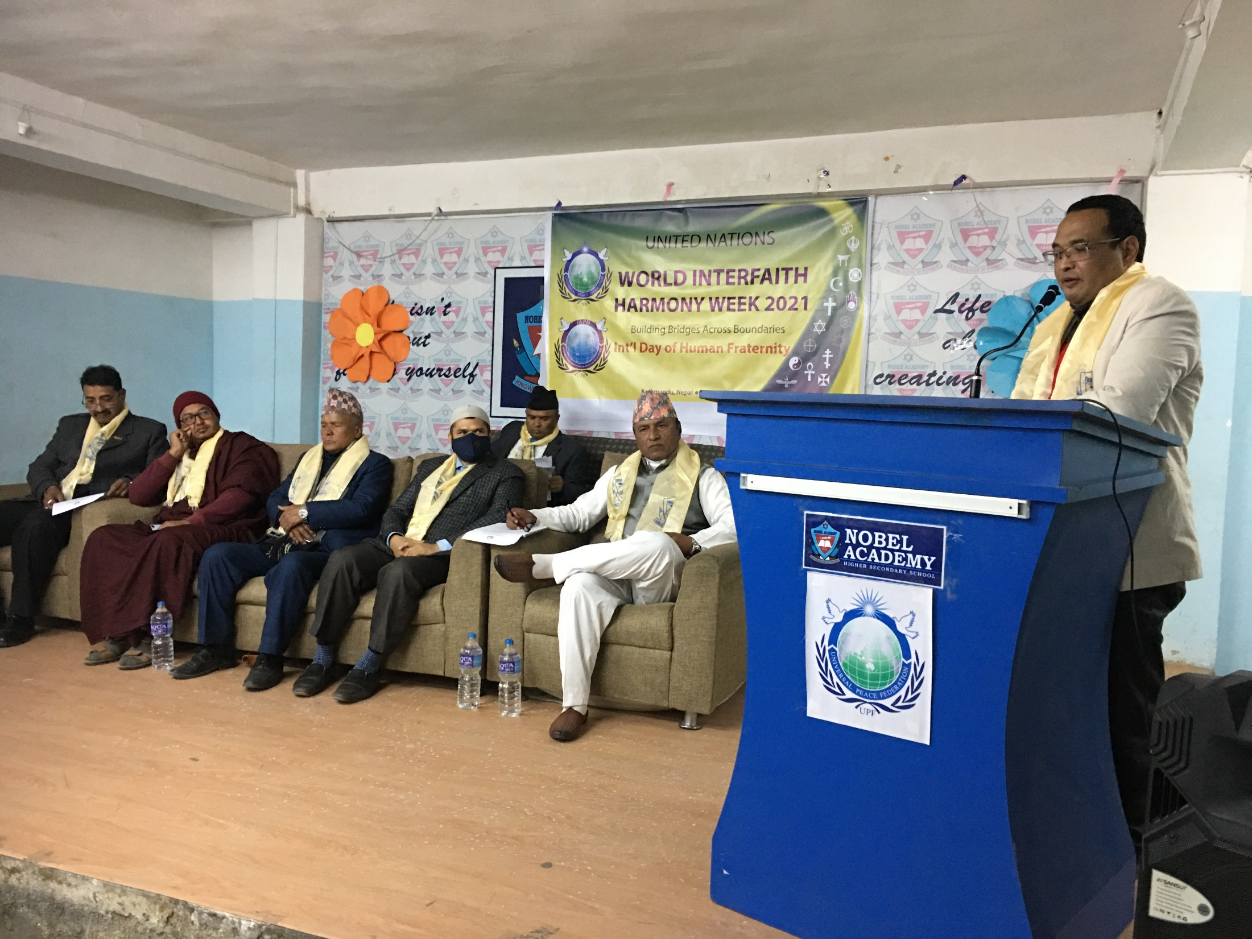
MC of the program, Dr. Piya Ratna Maharjan

Slide 5
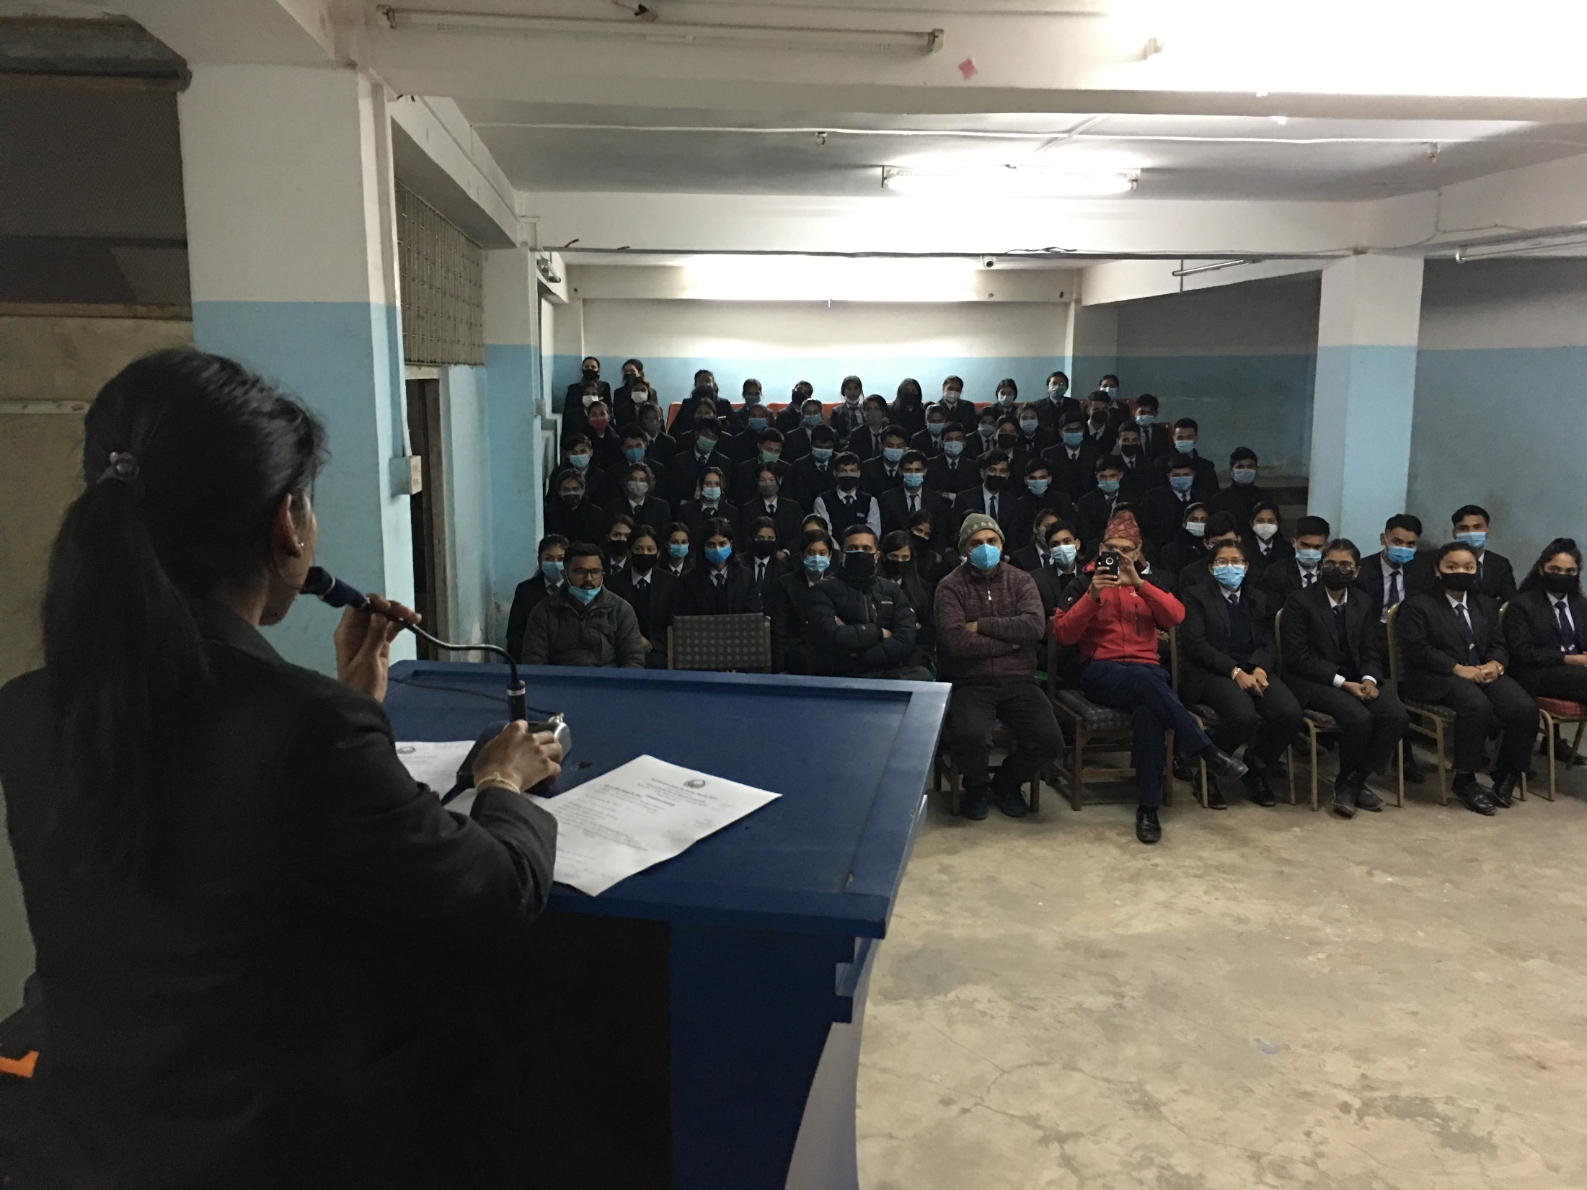
Welcome speech given by Ms. Shrestha, Student Coordinator of Nobel College

Slide 6
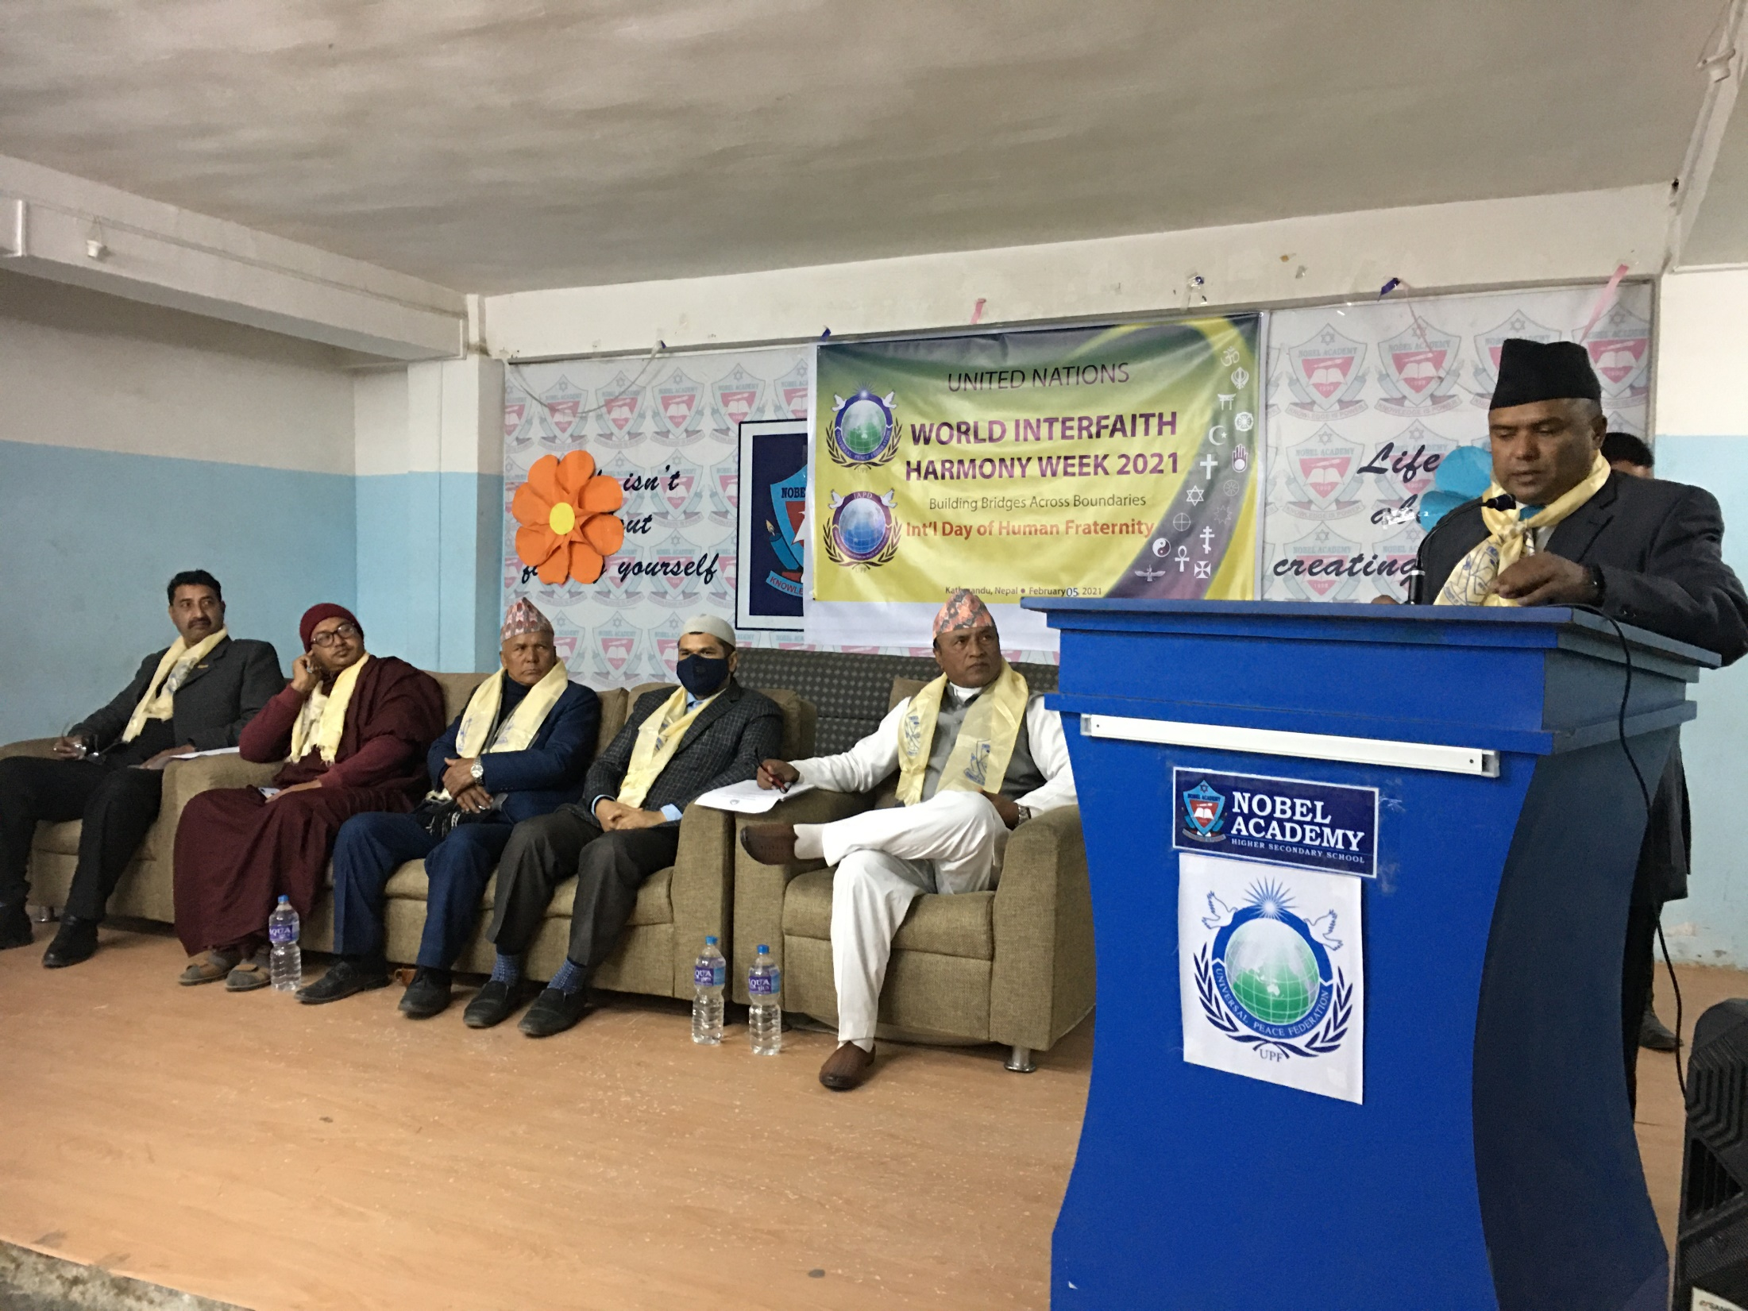
Mr. Binod Dangi, Secretary General, UPF Nepal giving the background of the program & UPF Statement of WIHW

Slide 7
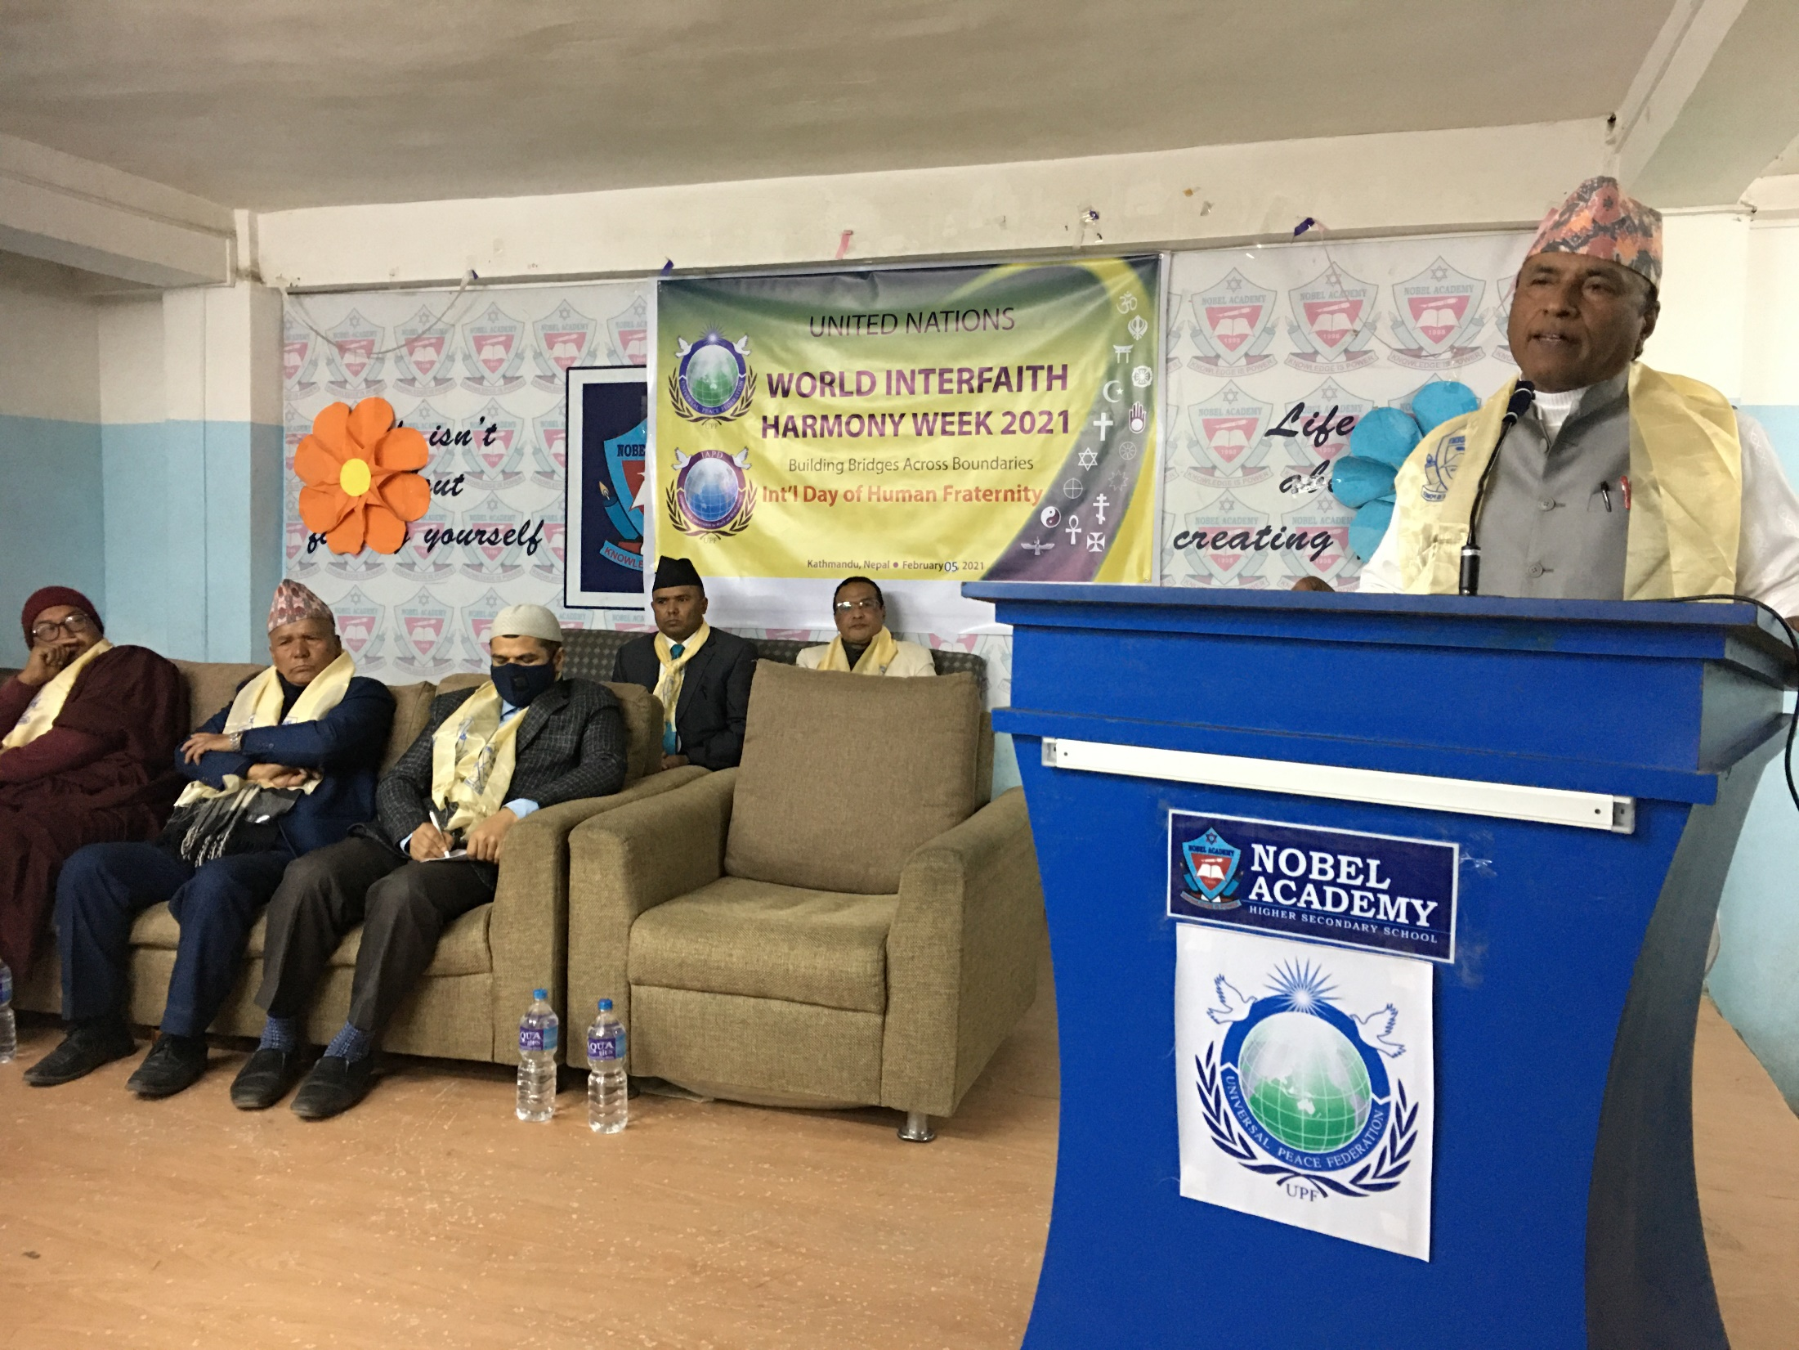
Prof. Swami Vinod Ananda, Gold medalist & President of World Awaken Mission Foundation.

Slide 8
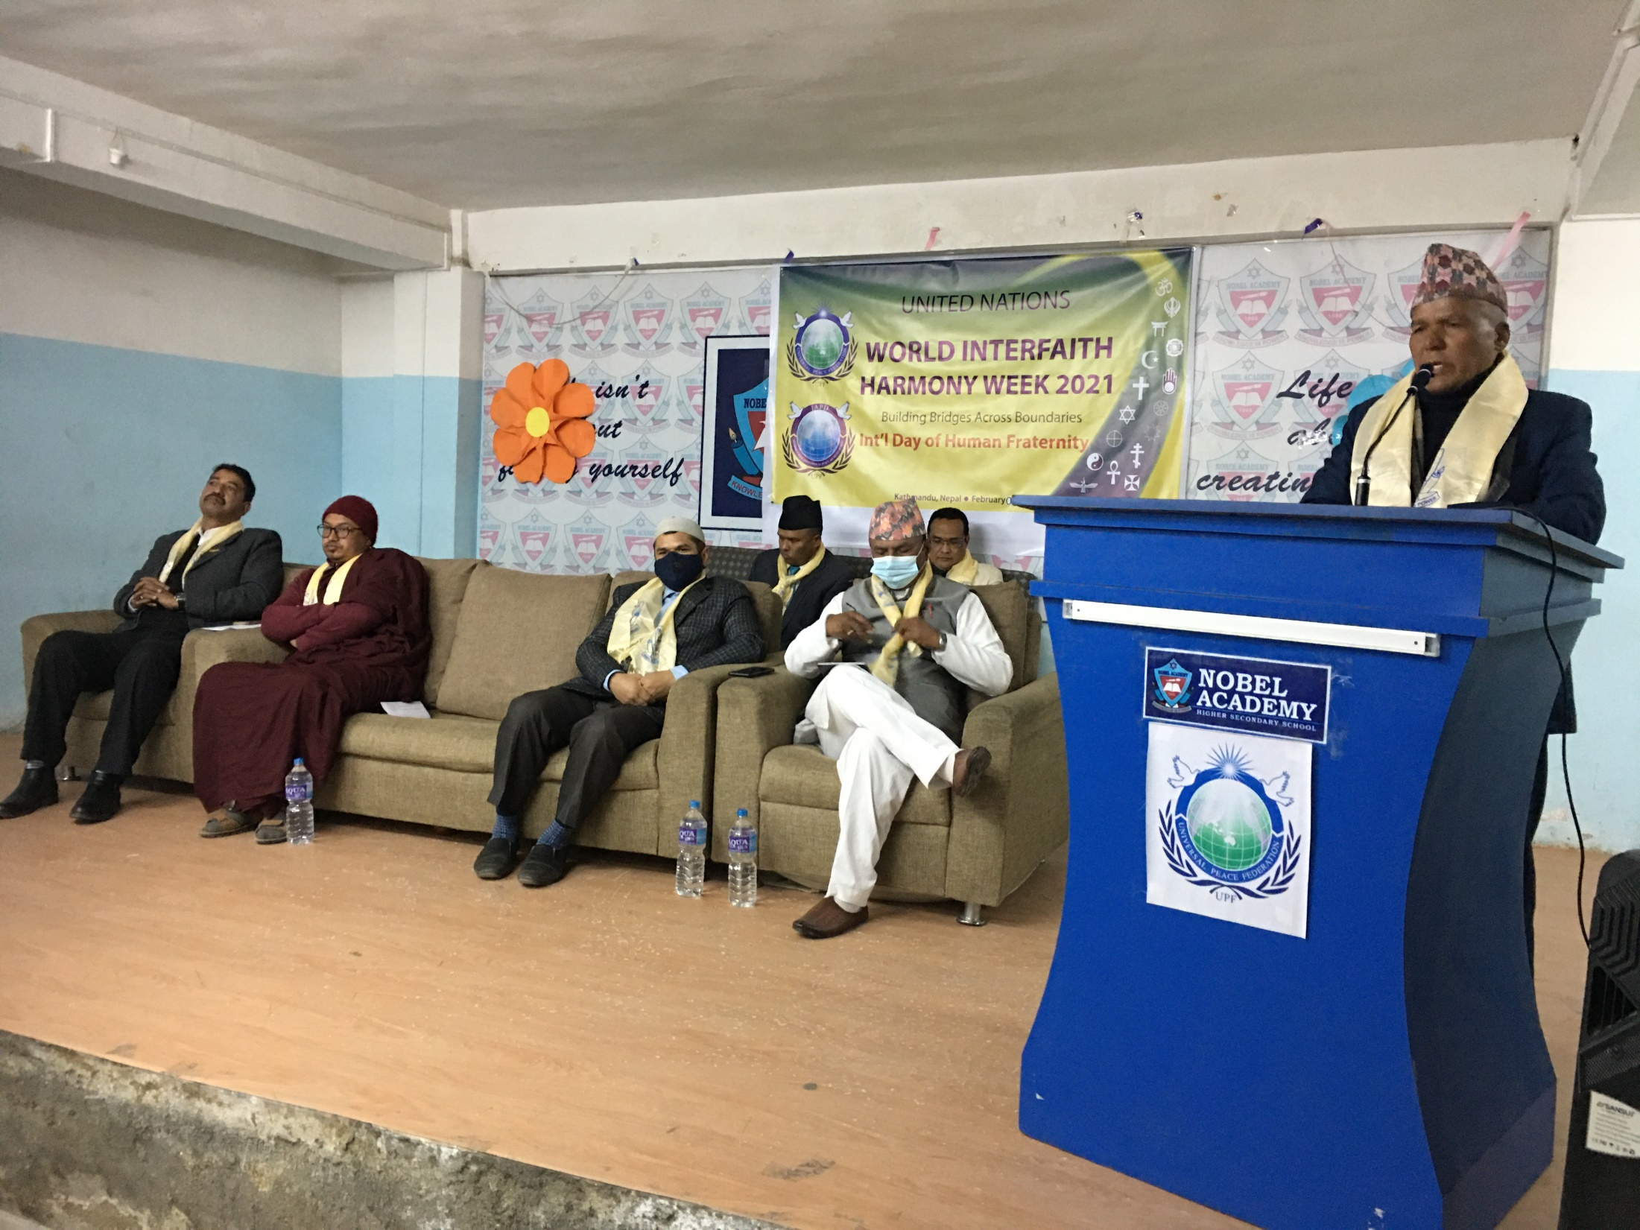
Prof. Dr. K.B. Rokaya, Former Hon. Member of Human Right Commission Govt. of Nepal from Christianity

Slide 9
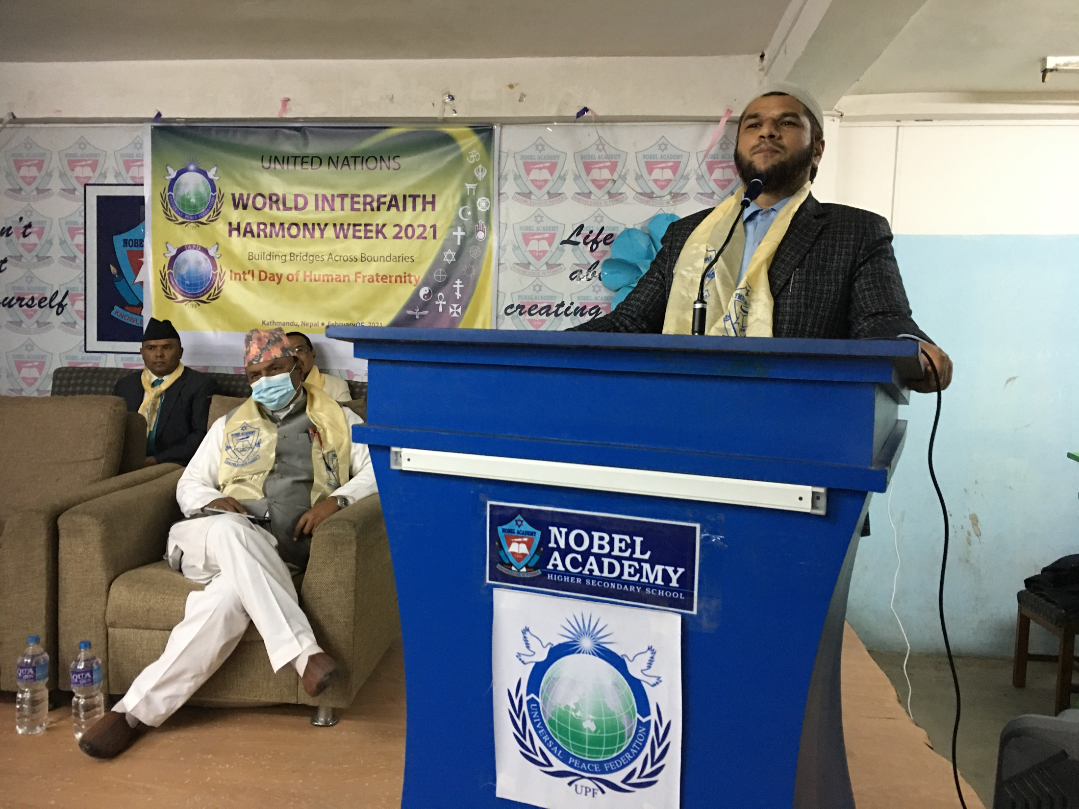
Mr. Moulana Abul Kalam Mia, Secretary General of Nepal Islamic Federation.

Slide 10
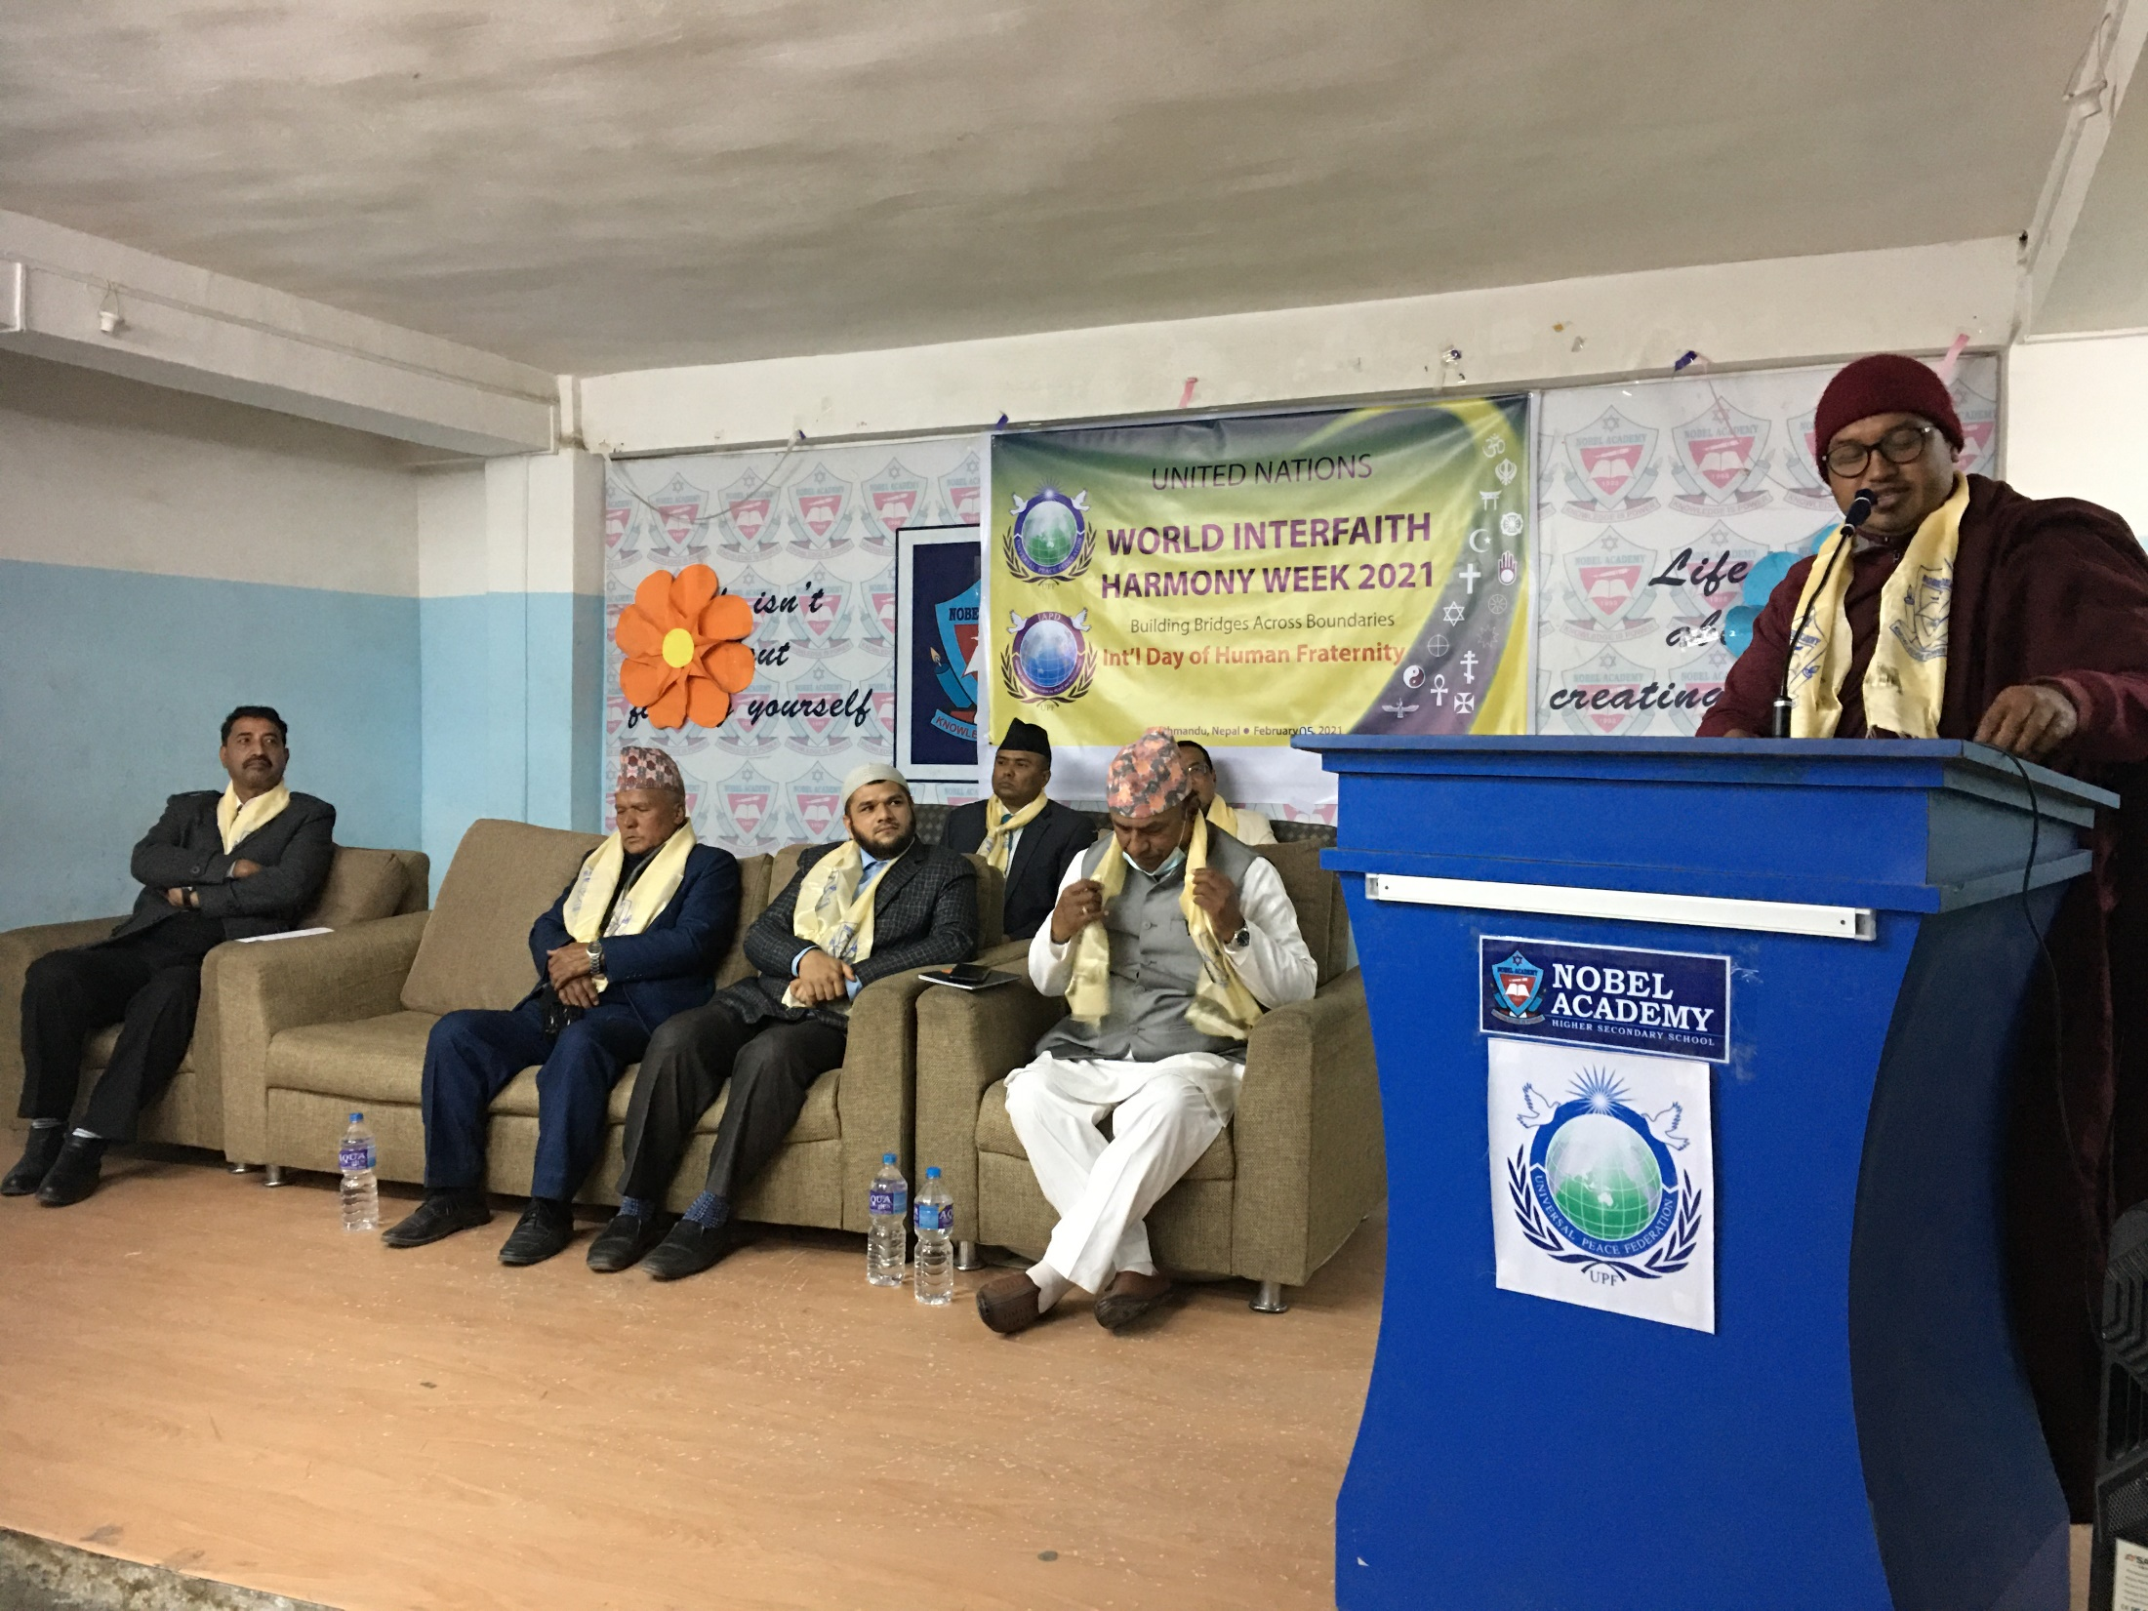
Ven. Bhante Piya Dassi, Board of Director of All Nepal Buddhist Association

Slide 11
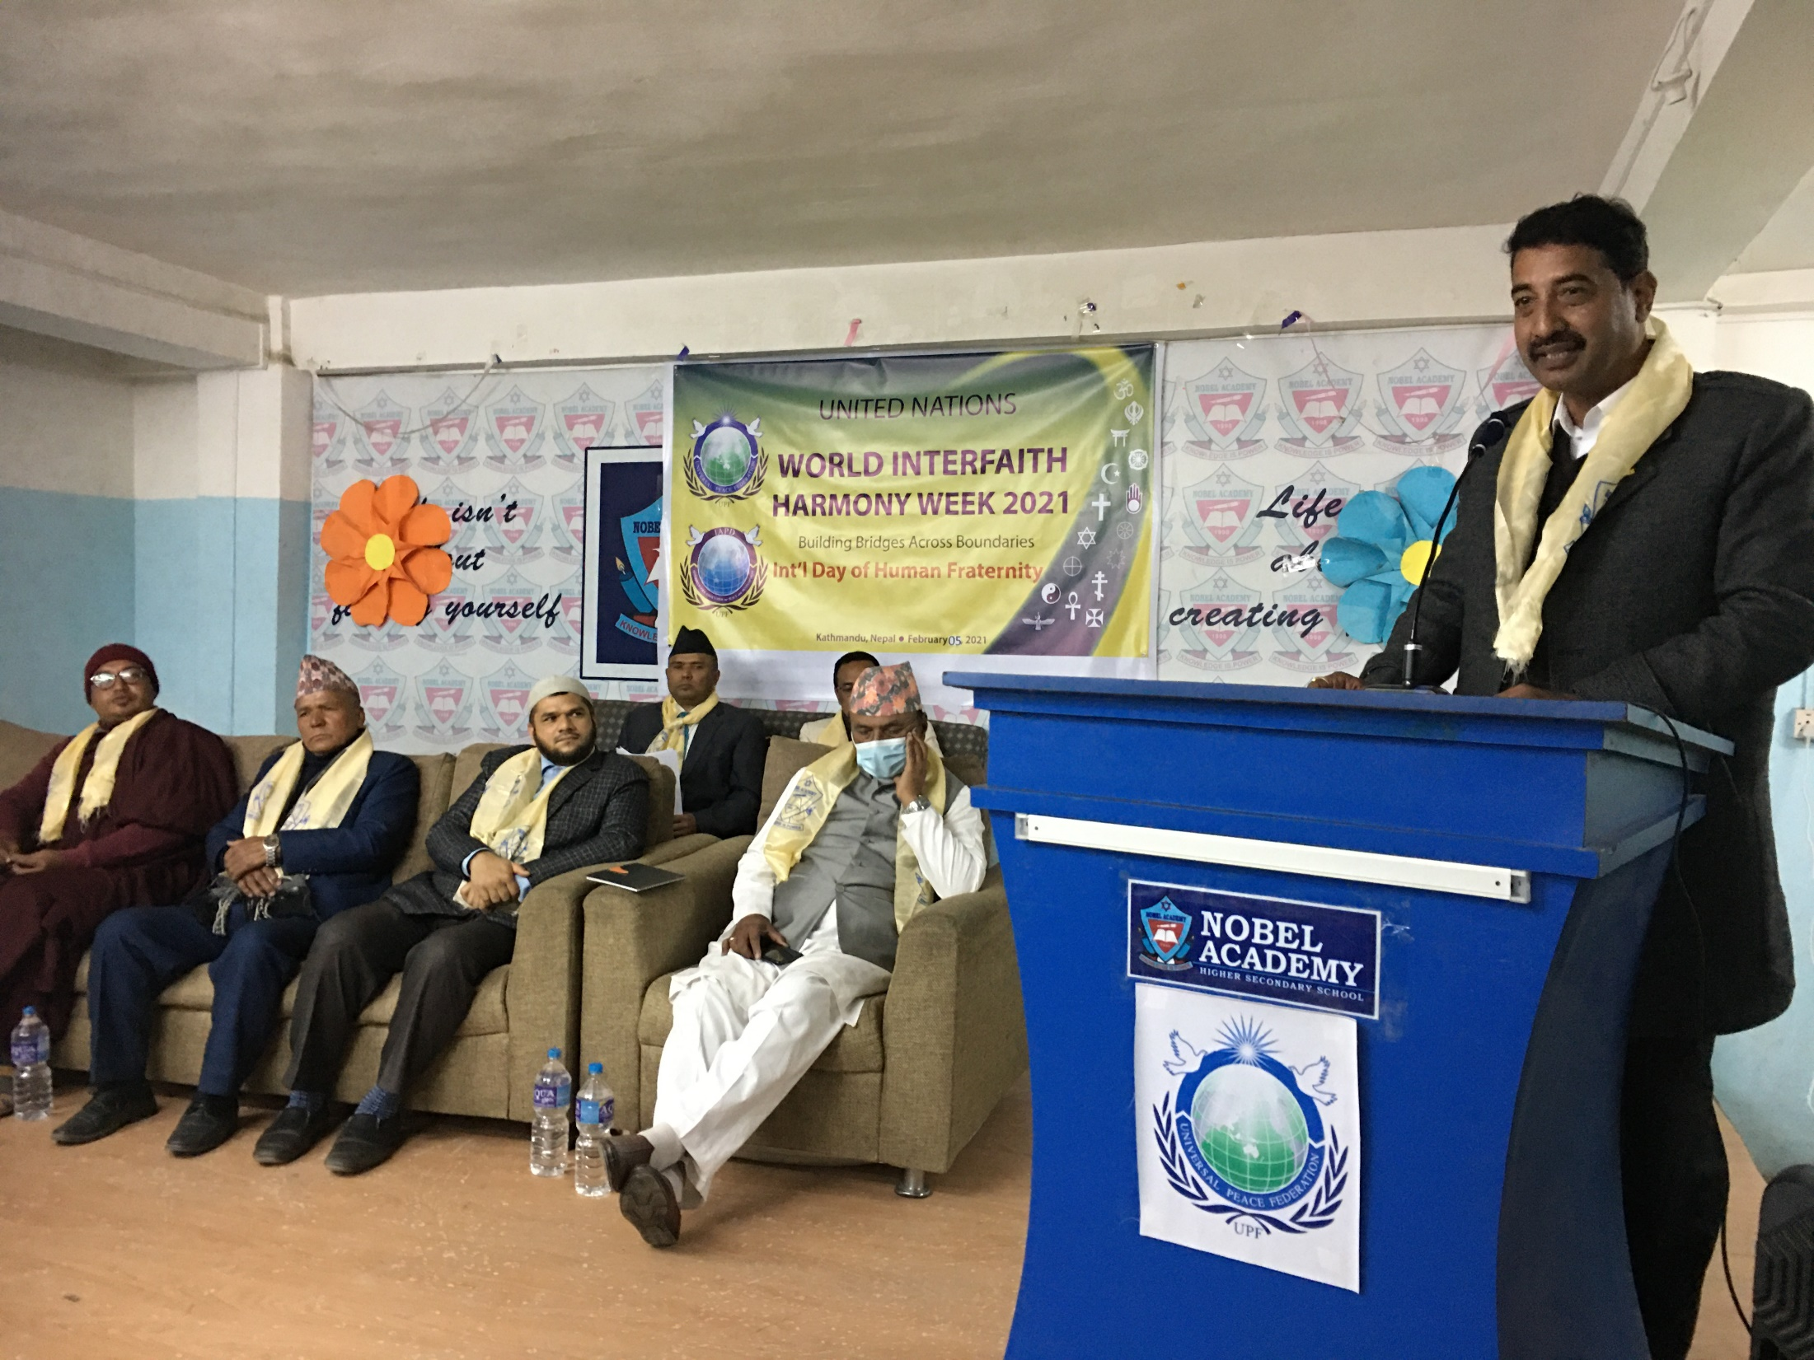
Closing remarks given by Founder of Nobel Academy & Chairperson of progrem: Mr. Surendra Shrestha

Slide 12
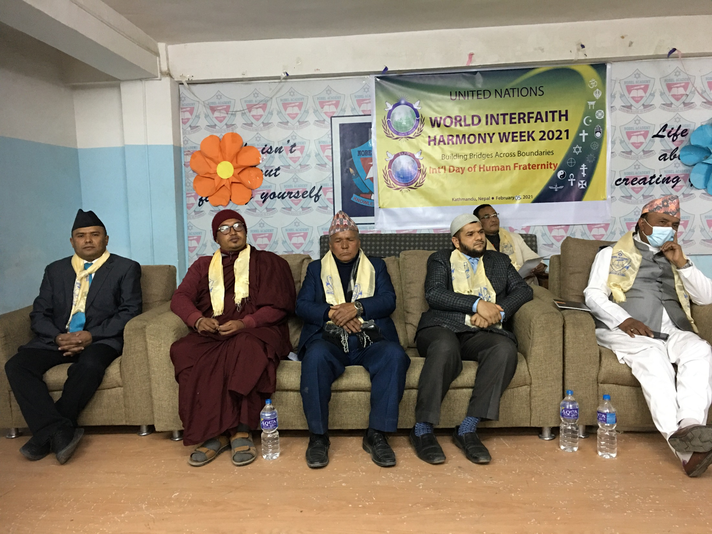
Religious Leaders

Slide 13
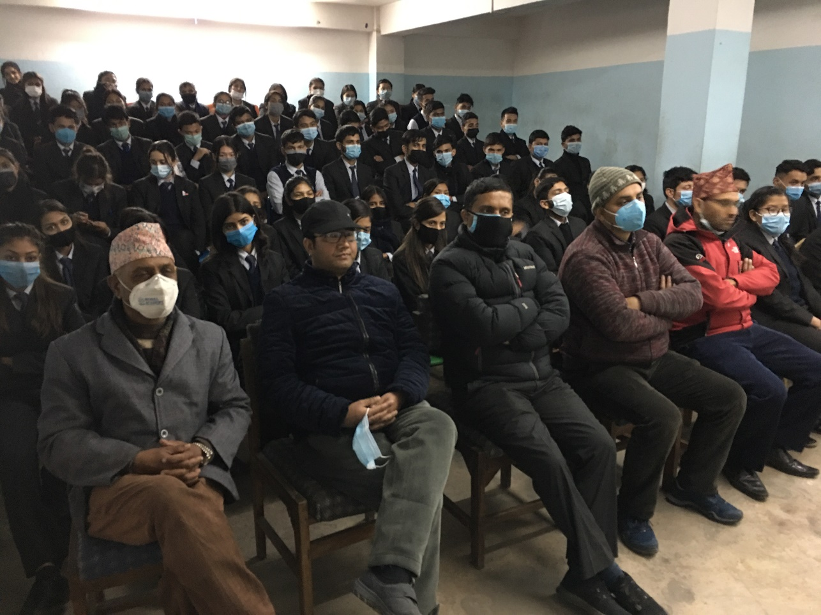
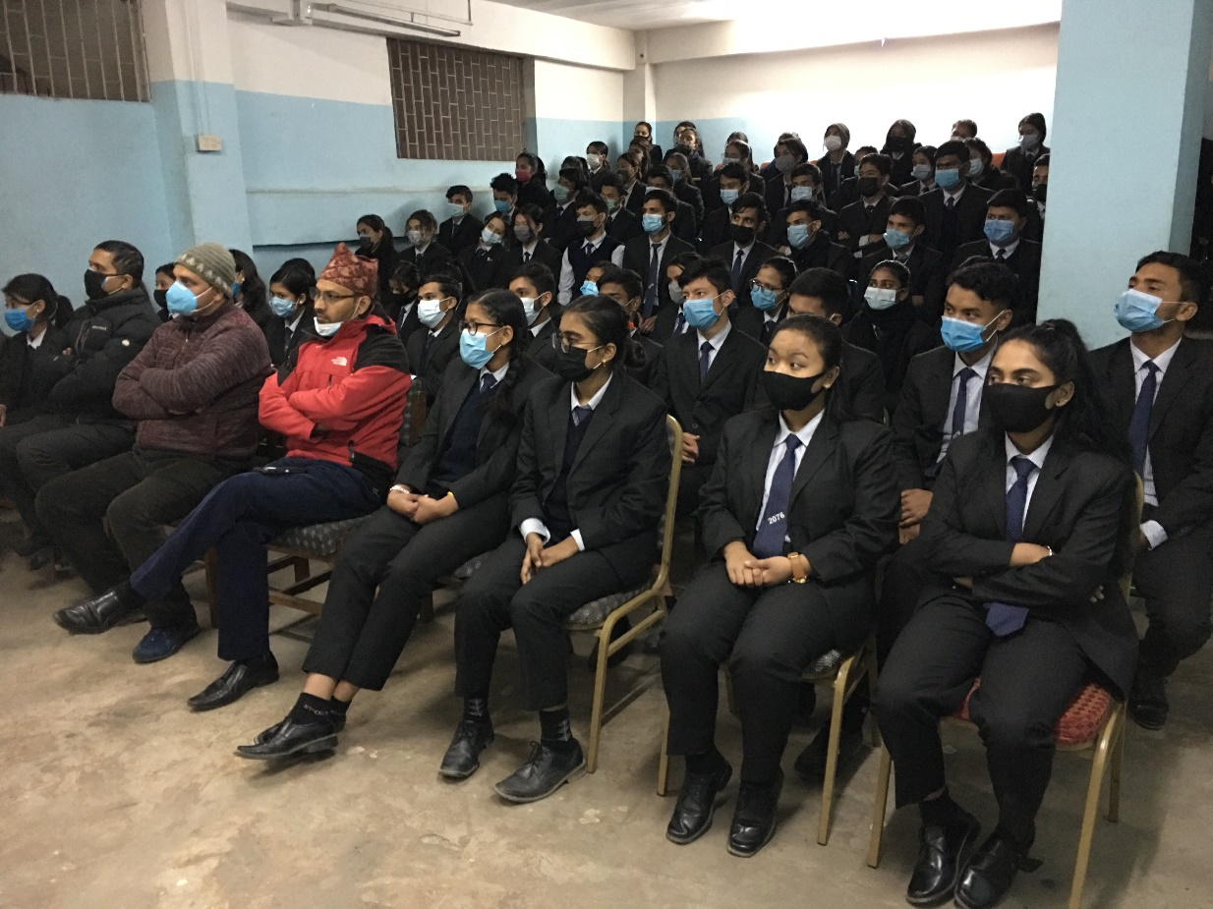
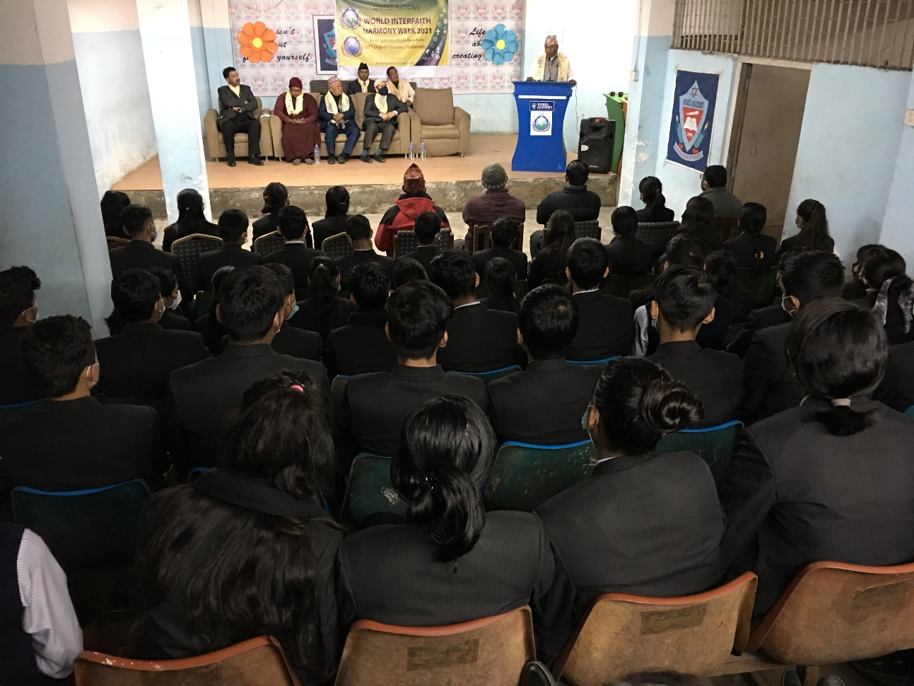
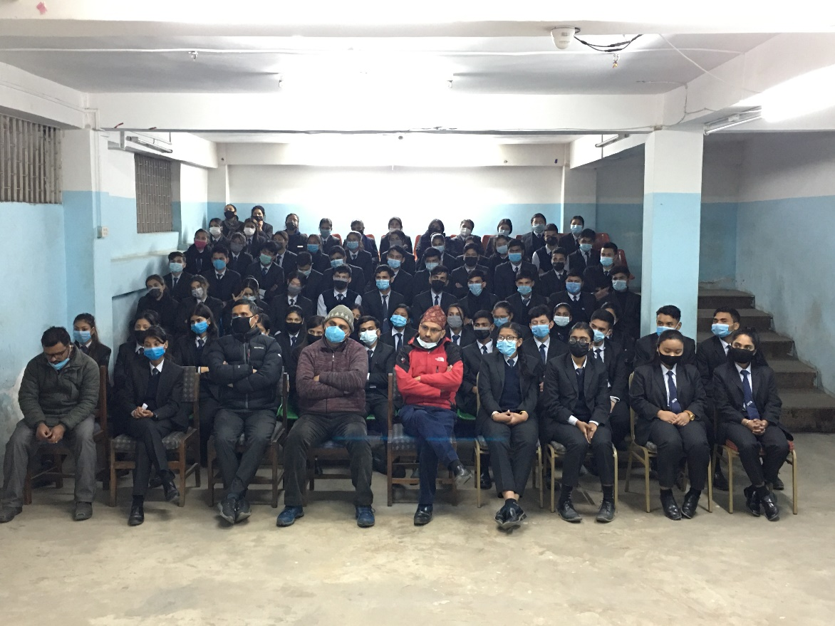
Group pictures

Slide 14
Thank you

