Slide 1
Women International Forum Kolding, Denmark
United Nations: World InterFaith Harmony Week
February 27, 2-5 pm
Via Teams møde

Slide 2
February 1-7 but with activities observed globally from last week of January to March 7

Slide 3
The official logo of the event

Slide 4
Principles for the celebration and observance
To create a culture of peace and non-violence
To promote harmony between all people regardless of their faiths
To have a global wave of understanding, respect and action in solidarity
To live out the principles of Love of God and Love of Neighbor found in holy scriptures in different religions, also taking up Love of the Good and Love of the neighbor as a human value that embraces also those who do not profess any belief or religion.
*First proposed by HM King Abdullah 11 and HRH Prince Ghazi bin Muhammad of Jordan. Accepted by the UN General Asssembly and then first carried out and observed from 2010…

Slide 5
På dansk/ In Danish
At skabe en kultur med fred og ikke-vold
At fremme harmoni mellem alle mennesker uanset deres tro
At have en global bølge af forståelse, respekt og handling i solidaritet
At udleve principperne om kærlighed til Gud og kærlighed til næste, som også findes i hellige skrifter i forskellige religioner.

Slide 6
One can go into the website and see our submitted reports in the past two years.
https://worldinterfaithharmonyweek.com/
How to participate
Event Calendar
Event Reports: 2020: reports of 5 activities
2019: reports of 6 activities
22 Brunch Fellowship
27 Sprogcafe
41 Lecture Evening
49 Women Encounter
97 Painting Exhibition
Faith Encounter with
students in public schools
1453 reports in 2019
1544 reports in 2020
2021 ?

Slide 7
Cancellations of activities in 2021 because of Corona and what remains is for women online…

Slide 8
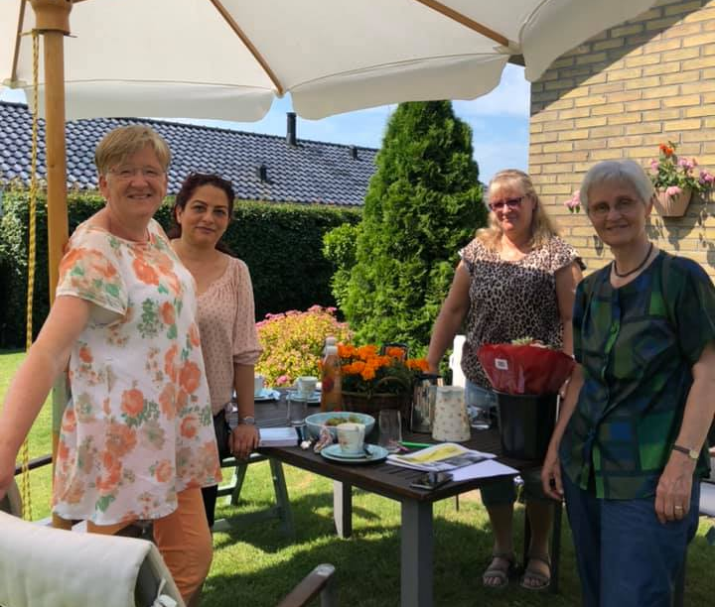
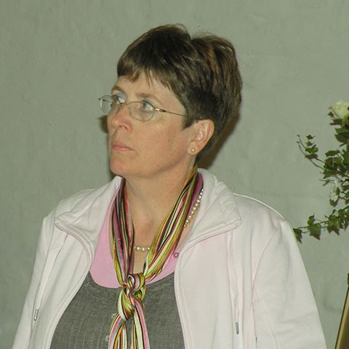
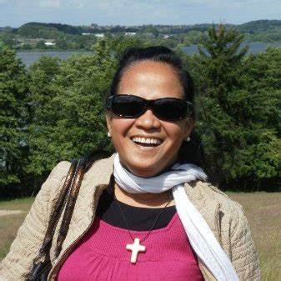
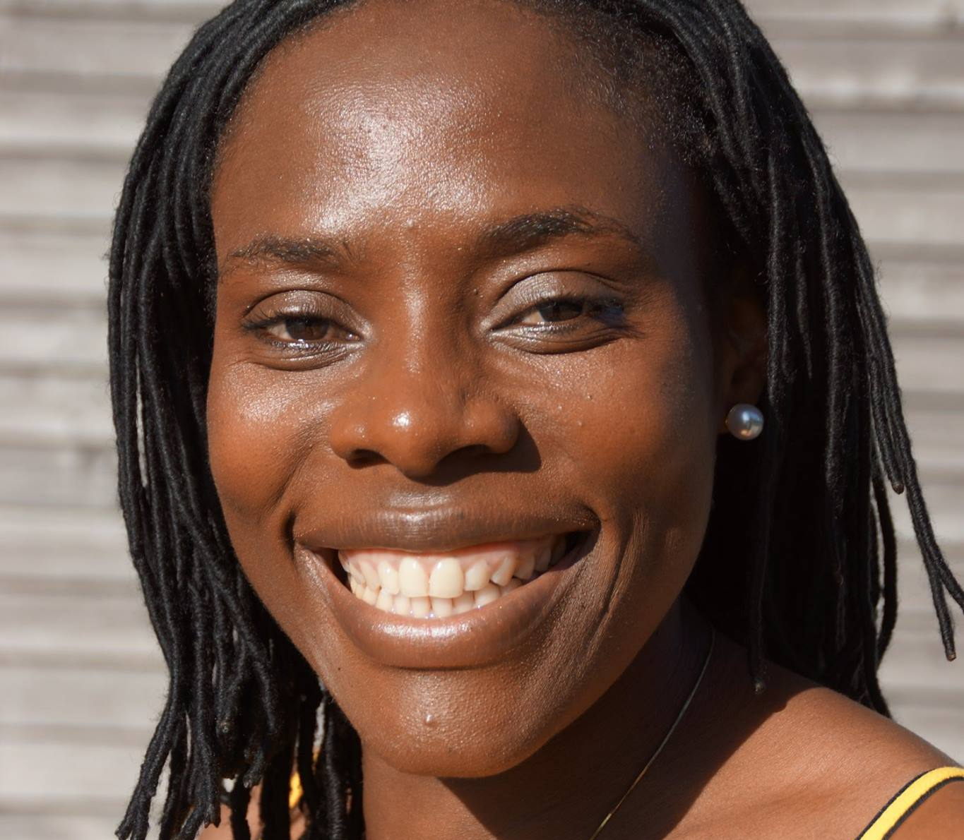
Committee of Women Encounter/Kvinder møder kvinder
7 kvinder i udvalget fra Danmark, Tanzania, Iran og Filippinerne

Slide 9
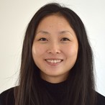
In cooperation with Mette Steel- Consultant of Migrant Work and Lutheran Church Encounter with other Religions of Haderslev Diocese(Haderslev Stift), consisting of 8 deaneries in 8 towns in Denmark)

Slide 10
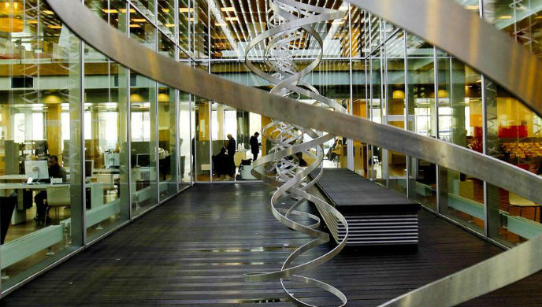
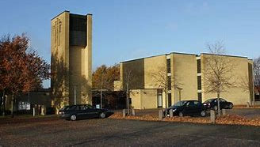
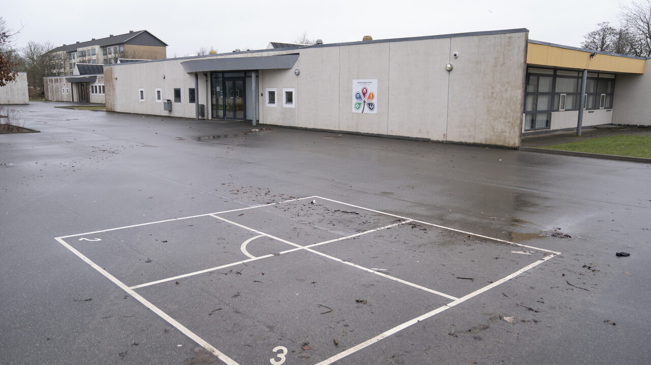
Our participation in UN World Interfaith Harmony Week in 2019, 2020 and 2021 by photos
Venues: (Steder vi har brugt)
Simon Peters Church
Simon Peters Hus
Munkevængets Skole
Kolding Library
Public Schools in Kolding K.
Online: Via Teams app

Slide 11
Welcome to people of diversity in faiths and cultures

Slide 12
Our observance in Kolding, the first two years:
2019
2020
Art Exhibition at Kolding Library with 12 artists with the town mayor, opening the exhibition.
Brunch Fellowship with inputs from leaders i following religions: Sikkism, Hindu, Muslim og Christian.
Art Exhibition at Kolding Library , 17 artists and Filipina Singing Group, Mayor Jørgen Pedersen
Opening of the Observance, first week in February by stories of the refugees and the thier experience with their Danish contact familie that help them in their integration and Brunch or Fellowship Meal.

Slide 13
2019
2020
3. Lecture Evening: by Ayden Soei, author of a book on reconciliation; held at Munkevænget School, offering the event also to teachers and organizations.
4. Women Encounter Women through Painting of Symbols in Religions
3. Lecture Evening: by an Iman and a Christian pastor on friendship and hospitality in Simon Peters Church,extending invitation to charitable organizations and to multi-ethnic leaders in Kolding within the Multicultural Forum of Kolding Municipality.
4. International Women’s Feast
(songs, dances and sharing of food from women’s own kitchens)

Slide 14
More on the activities for WIFHW…
2019
2020
5. Sprogcafe/ Teaching Danish to foreigners using FN World InterFaith Harmony Week as the lesson for the day in Danish.
6.Faith Encounter in Schools, religious dialouge with 9th graders in Public Schools in Kolding Kommune (Municipality)
5. Sprogcafe/Teaching Danish to foreigners with focus on the history and principles surrounding WIFHW

Slide 15
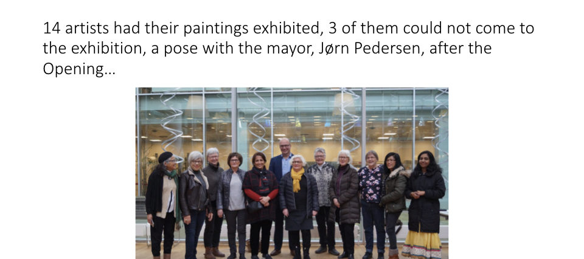
First Painting Exhibition 2019

Slide 16
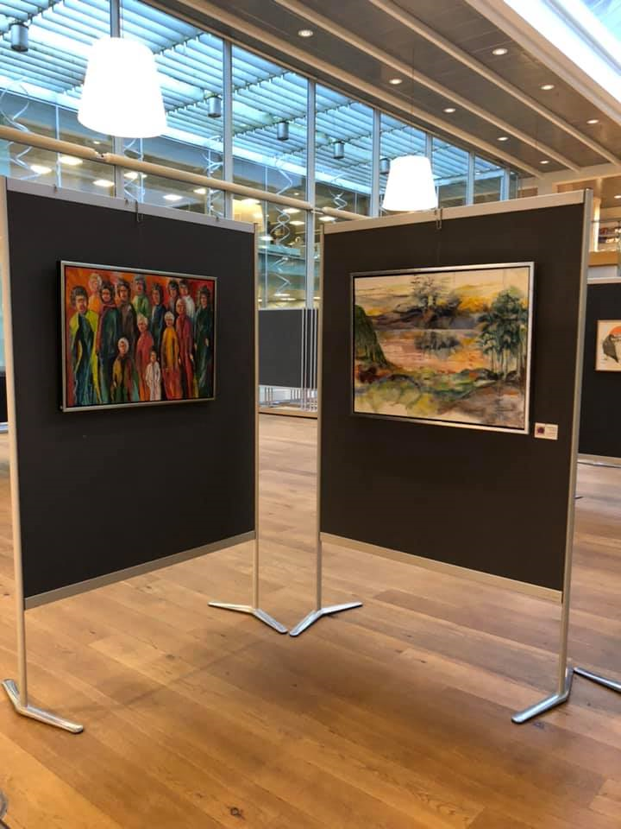
17 artists exhibited their art

Slide 17
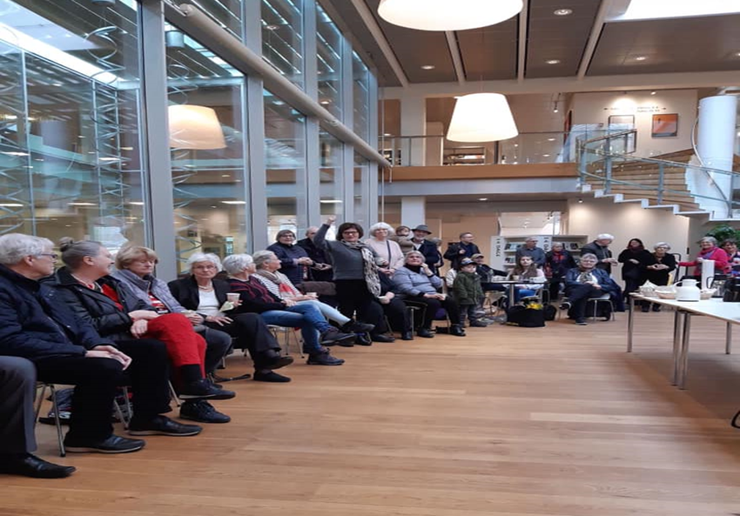
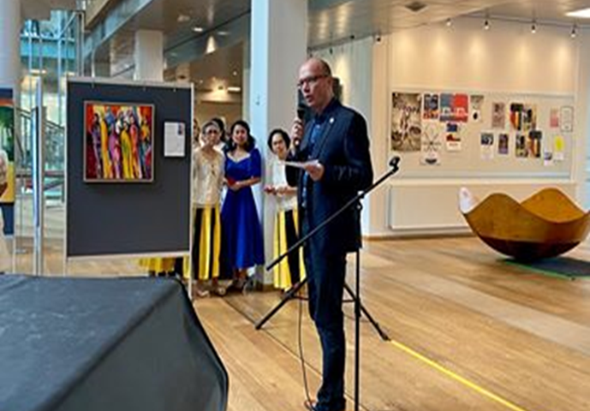
The mayor, Jørgen Pedersen, opened the Art Exhibition at Kolding Library

Slide 18
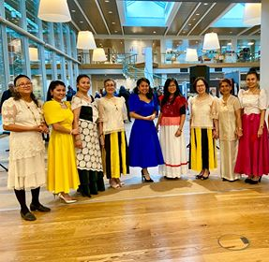
Filipina Singing Group singing and dancing for the opening of the Art Exhibition

Slide 19
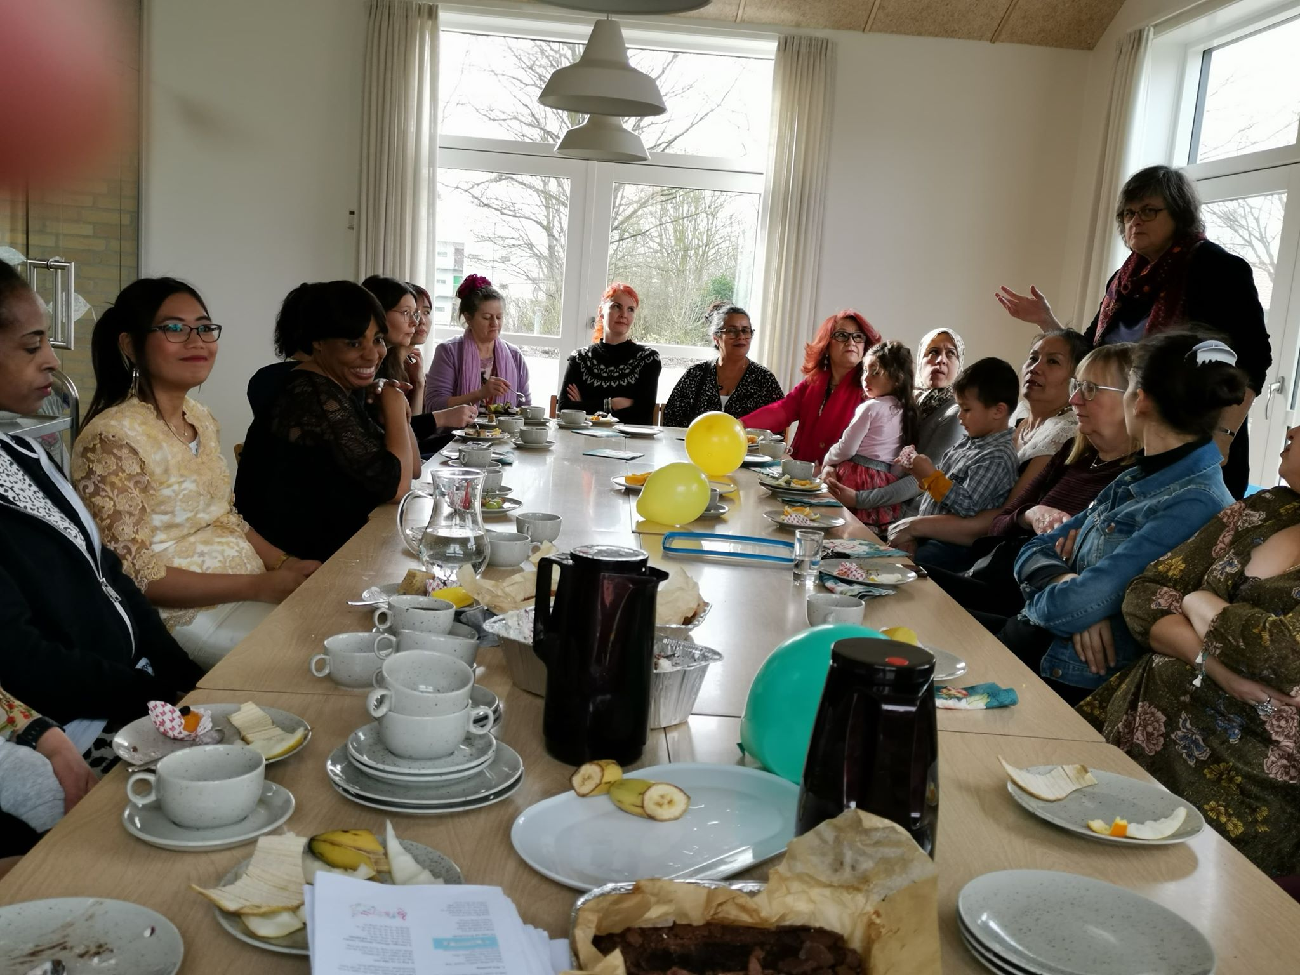
International Women’s Feast, Simon Peters Hus

Slide 20
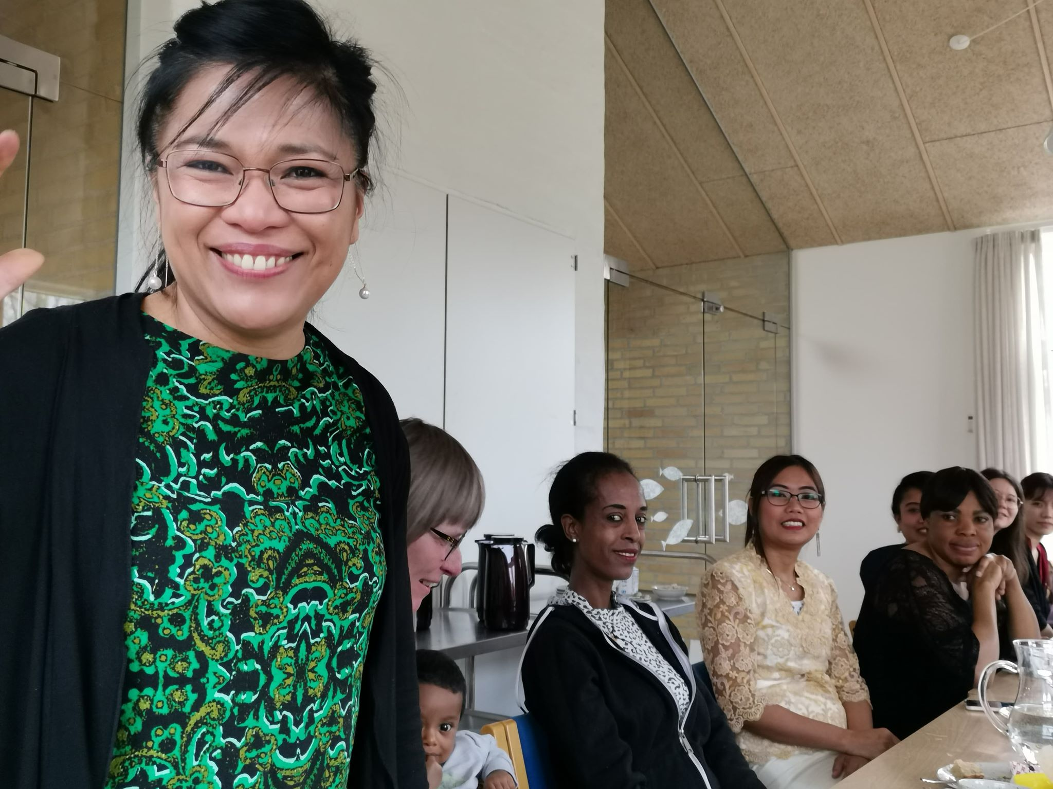
Women sharing

Slide 21
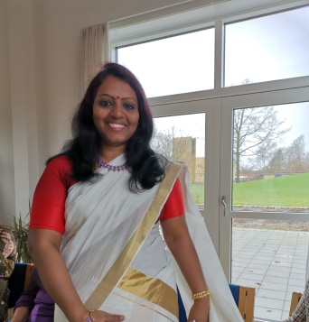
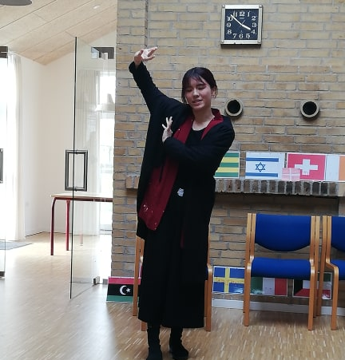
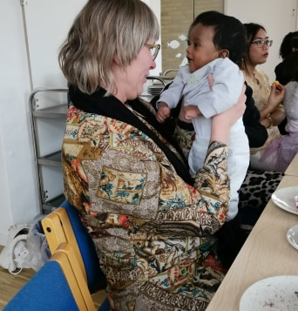
Flags, dances, food, children

Slide 22
Sharing of concerns as women…
Lande repræsenteret: Island, Brazil, DK, Afghanistan, Kina, India, Philippines, Iran ,
Thailand, Eritrea, Congo, Poland, Syrien, Iraq,Tanzania, Hungary, Lithunia…

Slide 23
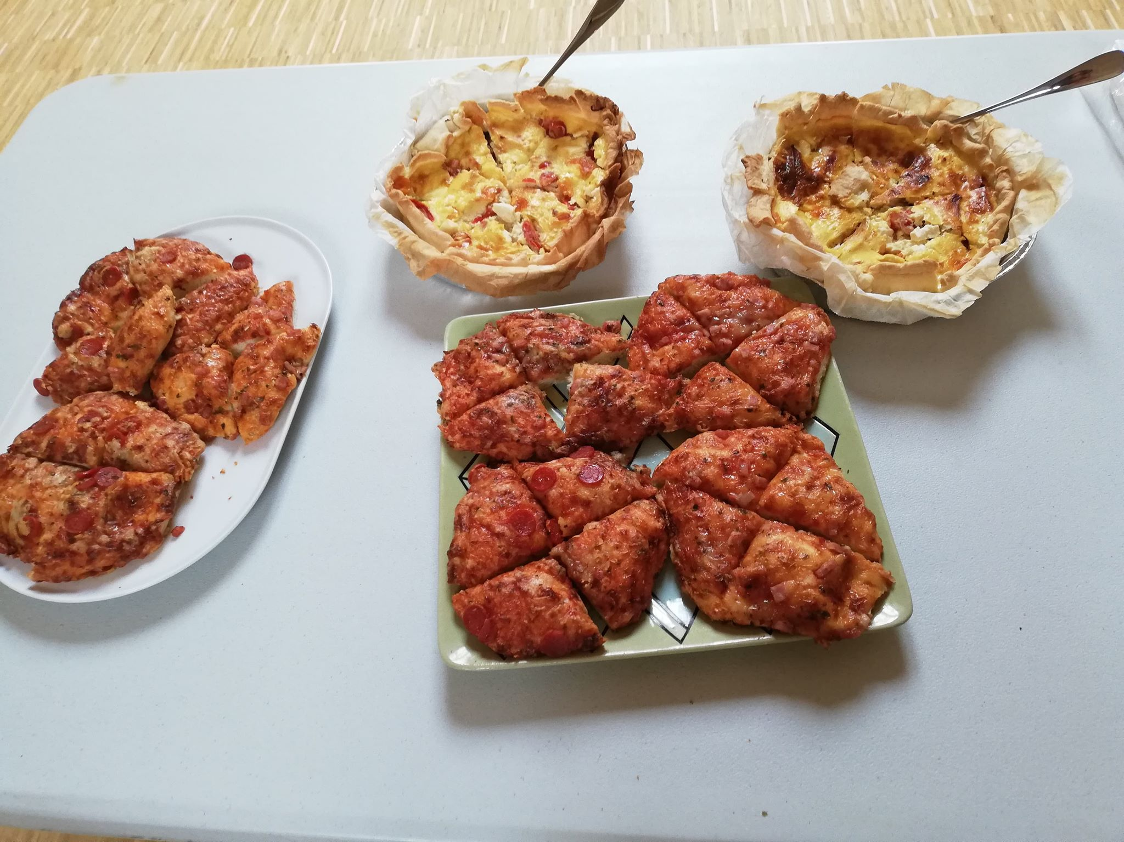
Women love to cook
Women love to share their food and be tasted by others…

Slide 24
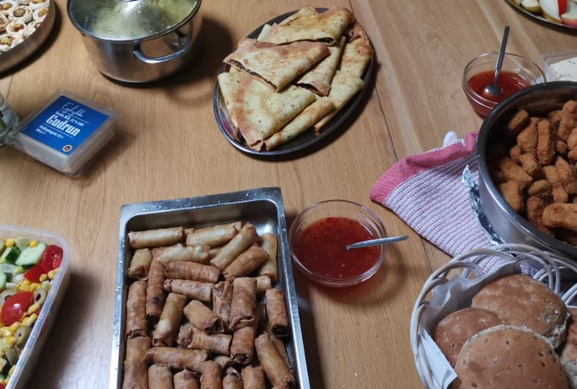
Brunch Fellowship
Each one brought food to the common table. Note: During Corona crisis all events with food and eating together are cancelled.

Slide 25
Brunch with speakers from 4 religions
Christianity
Islam
Shikkism
Hinduism

Slide 26
Lecture Evening on Friendship, Hospitality and Compassion
Pastor Niels Nymann Eriksen
Imam Ahmet Polat

Slide 27
Venue: Simon Peters Church
Time for presentation and dialogue

Slide 28
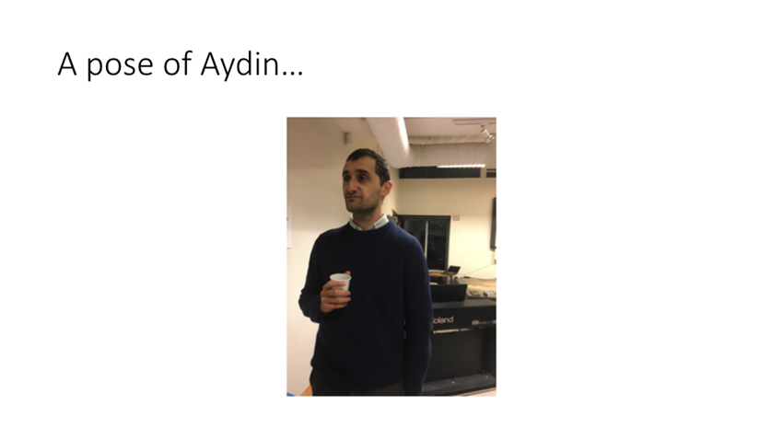
Lecture evening on Reconciliation from his book of Aydin Soei
Venue: Munkevængets Skole

Slide 29
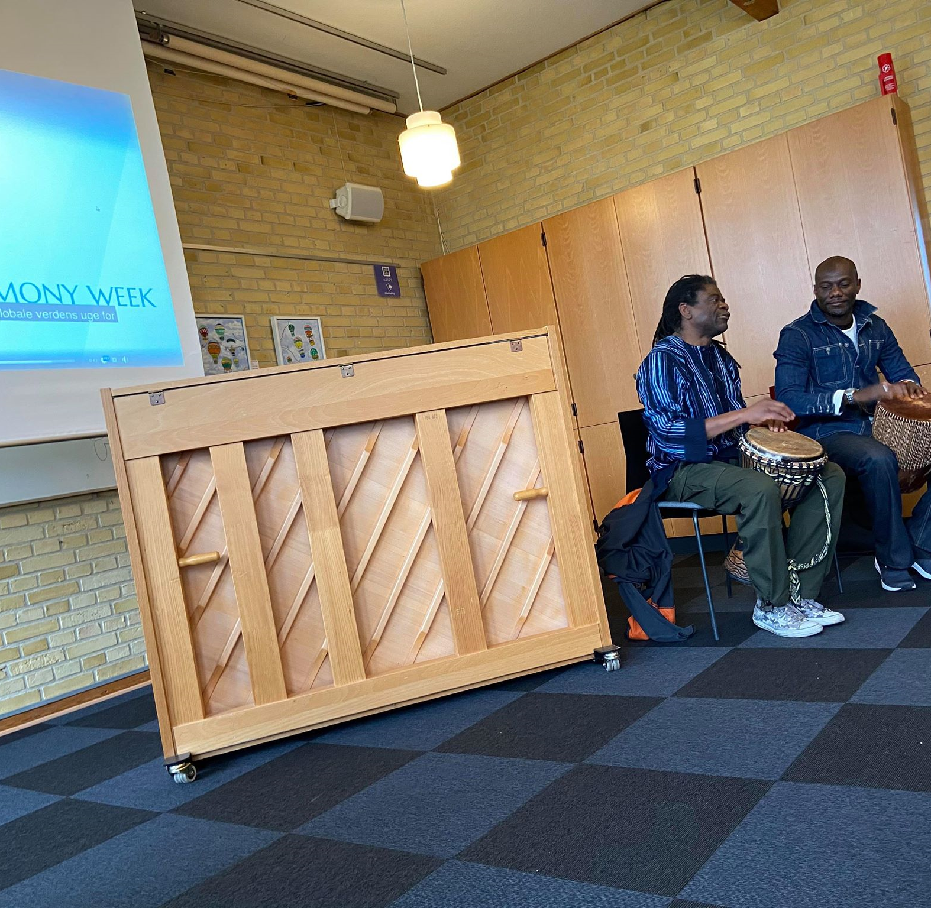
The Opening Day WIFHW in February at the SPK Church

Slide 30
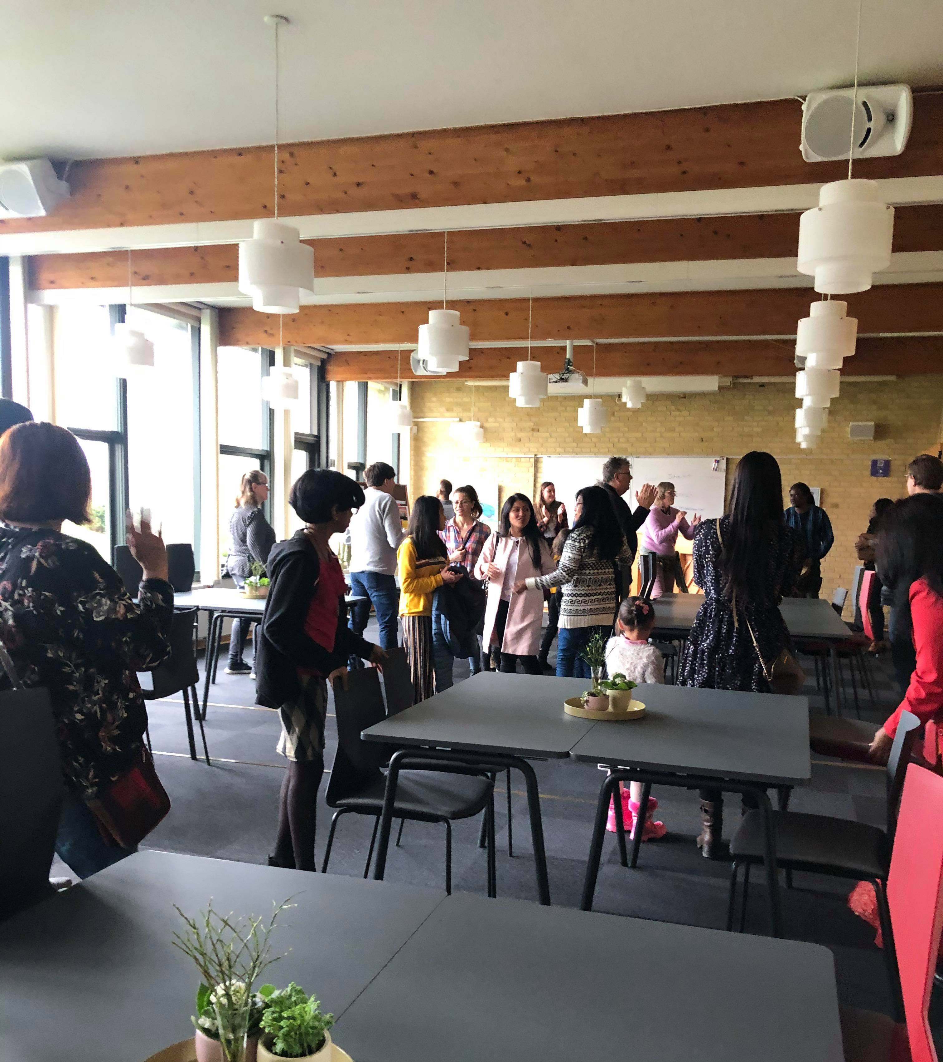
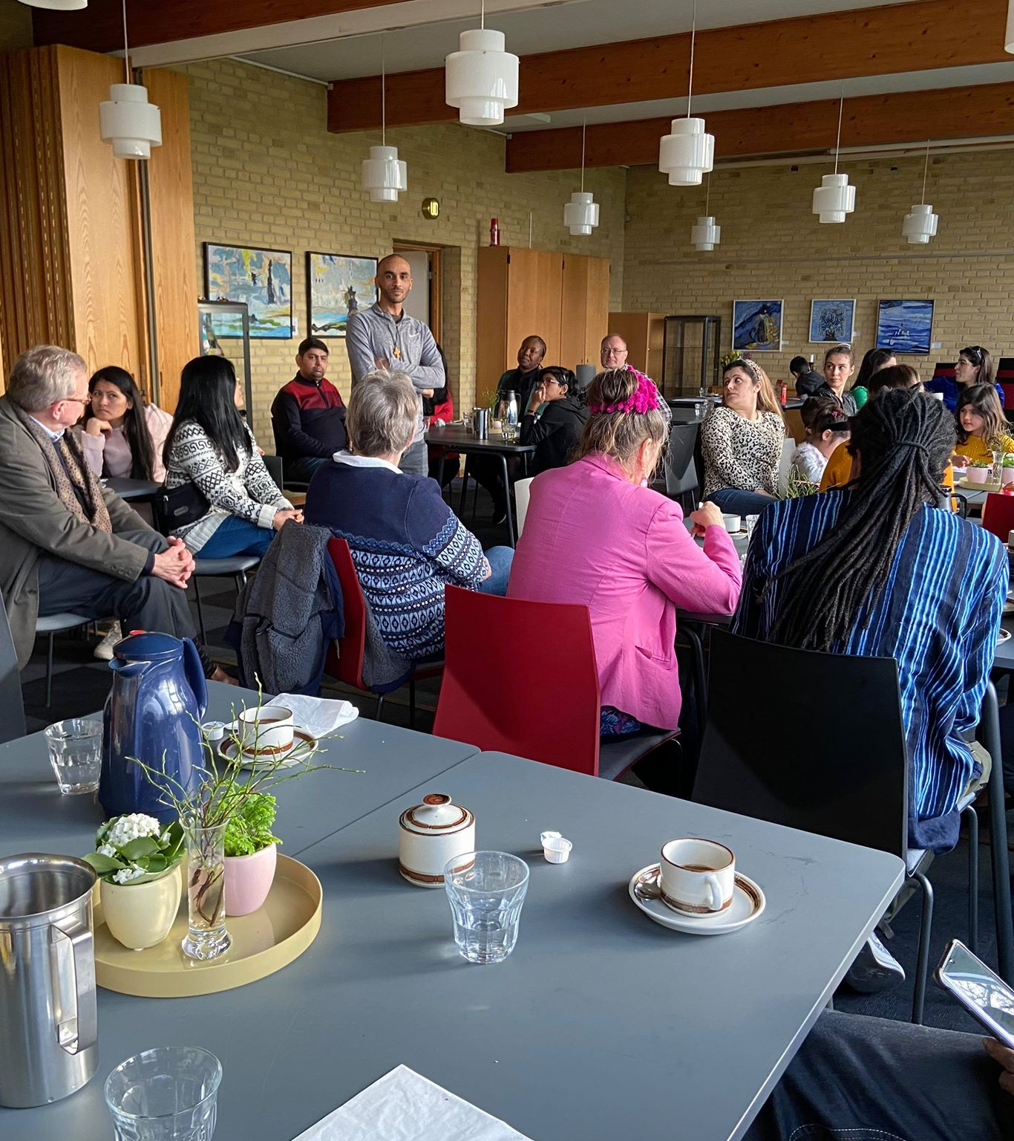
Opening of the World Interfaith Harmony Week with stories of Refugees and their contact families

Slide 31
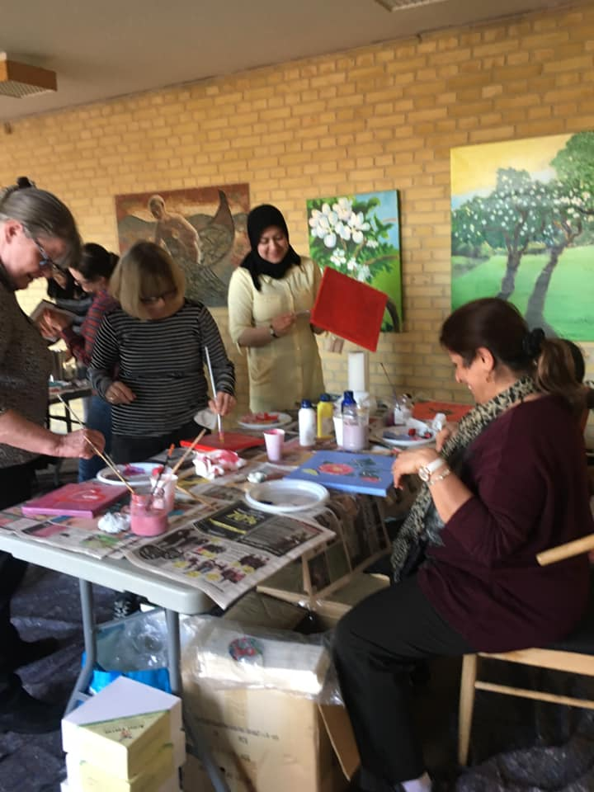
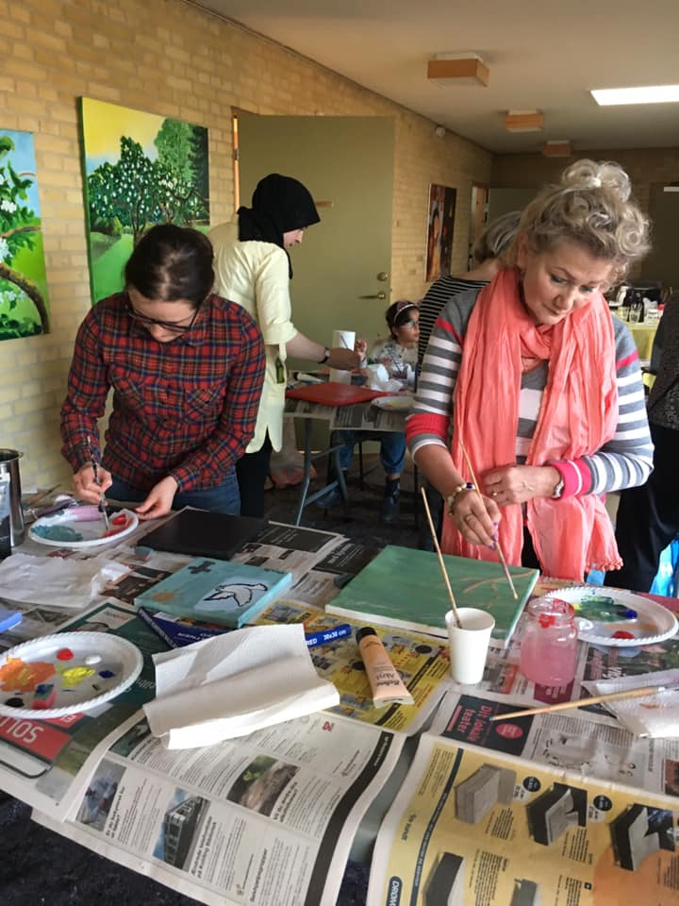
Painting Workshop: Symbols in religions

Slide 32
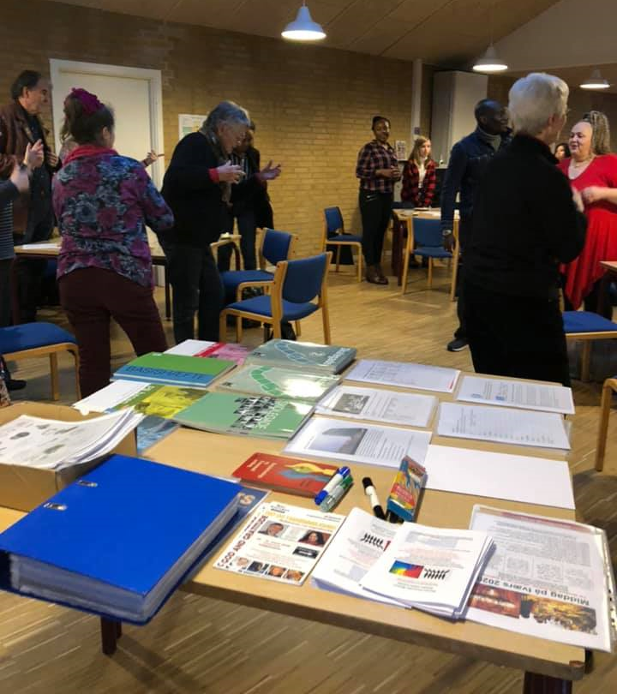
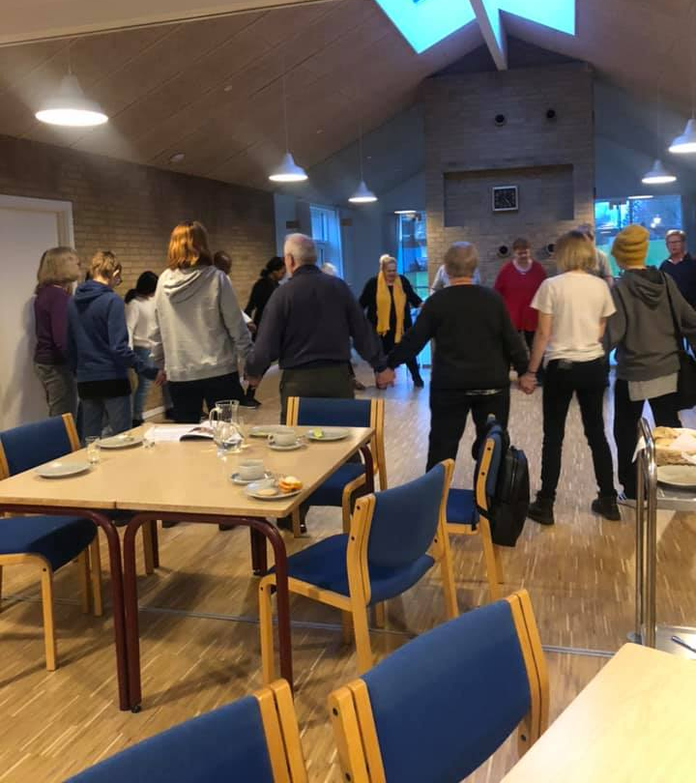
Sprogcafe

Slide 33
2021 and Corona restrictions, lockdown and cancellations
What remains:
Women International Forum
Program of our observance of UN World Interfaith Harmony Week 2021 was planned, coordinated, agreed, ready to be implemented, but had to be cancelled with the second lockdown in Denmark from December to February 2021. Left choice: Online Women International Forum
cancelled AFLYST ! Aflyst
cancelled
cancelled
cancelled
cancelled

Slide 34
Our objectives today:
At have en forståelse for, hvad vi har til fælles som kvinder i mangfoldighed
At kende FN World Inter Faith Harmony Week og dens betydning for fred og harmoni i vores verden og til os som kvinder i vores egne sammenhænge.
At bede sammen om spørgsmål, der vedrører os på et personligt, lokalt, nationalt og globalt plan.
To have an understanding on what we have in common as women in diversity .
To learn on UN World InterFaith Harmony Week and its significance for peace and harmony in our world and to our life as women in our own contexts.
To pray together on personal, local, national and global concerns .

Slide 35
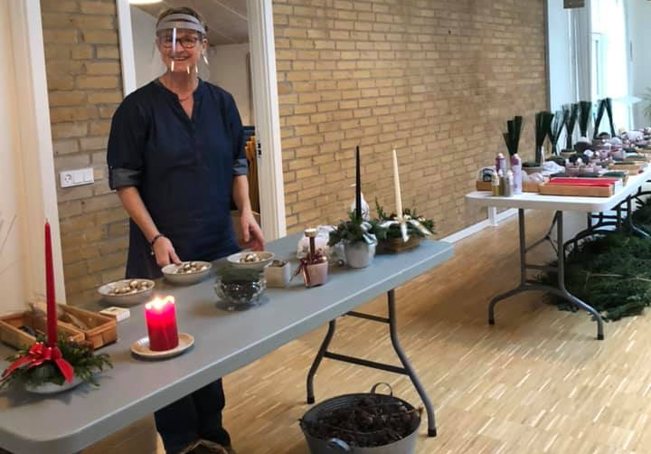
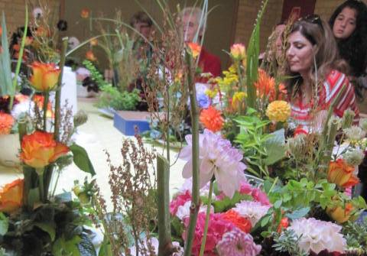
Christmas decorations and Flower Arrangement by women done at Simon Peters Hus. Just concluding with flowers to cheer us up and express our longing for spring and dream that Covid-19 will soon be over!

