Slide 1
Definition of Hate
Hate is:
A mindset
An emotion
An expression of regret
A learned perception
A learned behavior
A target of dislike
A negative action
Dr. Deborah E. Levin
05/30/19
Hate is not opposite the of love, it is actually part of a threefold structure:
Love , Hate, and Indifference.

Slide 2
“Hate” in Different Languages
Bosnian: mrziti
Chinese: 恨
Croatian: mrziti
Danish: Hade
Dutch: haten
Finnish: vihata
French: haïr
German: hassen
Greek: μίσος
Hindi: घृणा करना
Italian: odiare
Japanese: 憎む
Latin: odisse
Latvian: ienīst
Norwegian: hate
Polish: nienawidzić
Portuguese: odiar
Romanian: urî
Russian: ненавидеть
Slovene: sovražiti
Spanish: odiar
Swedish: hata
Telugu: ఏవగించుకొను
Turkish: nefret etmek
Welsh: casáu

Slide 3
Researching Definitions of Hate
Twenty-six definitions of hate were pulled from 212 Google search results.
The definitions were copied into a Wordle.com format.
Wordle.com displays analytic results visually by increasing the size of words appearing most frequently over other words
The largest words in the color and black & white versions of the same image are the ones appearing most frequently in definition results.

Slide 4
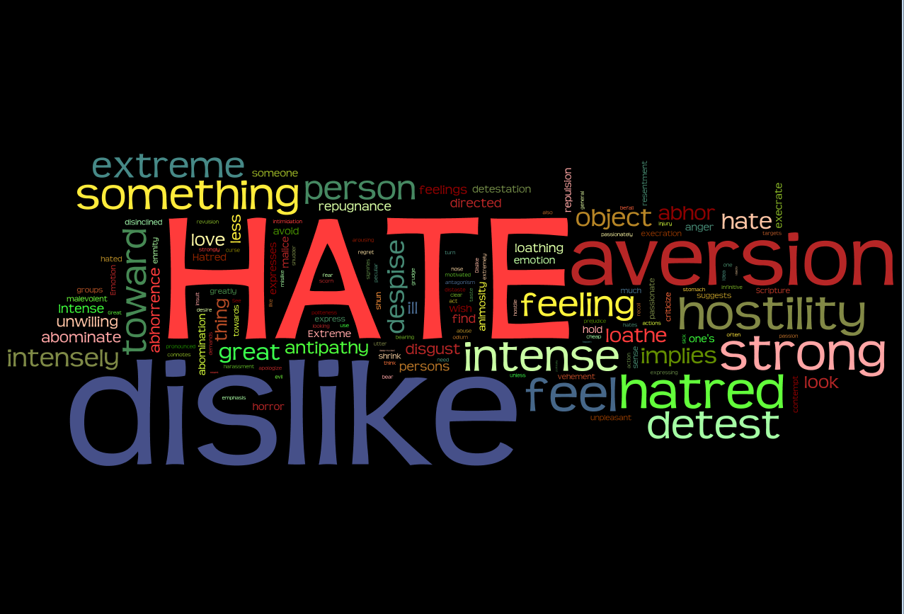

Slide 5
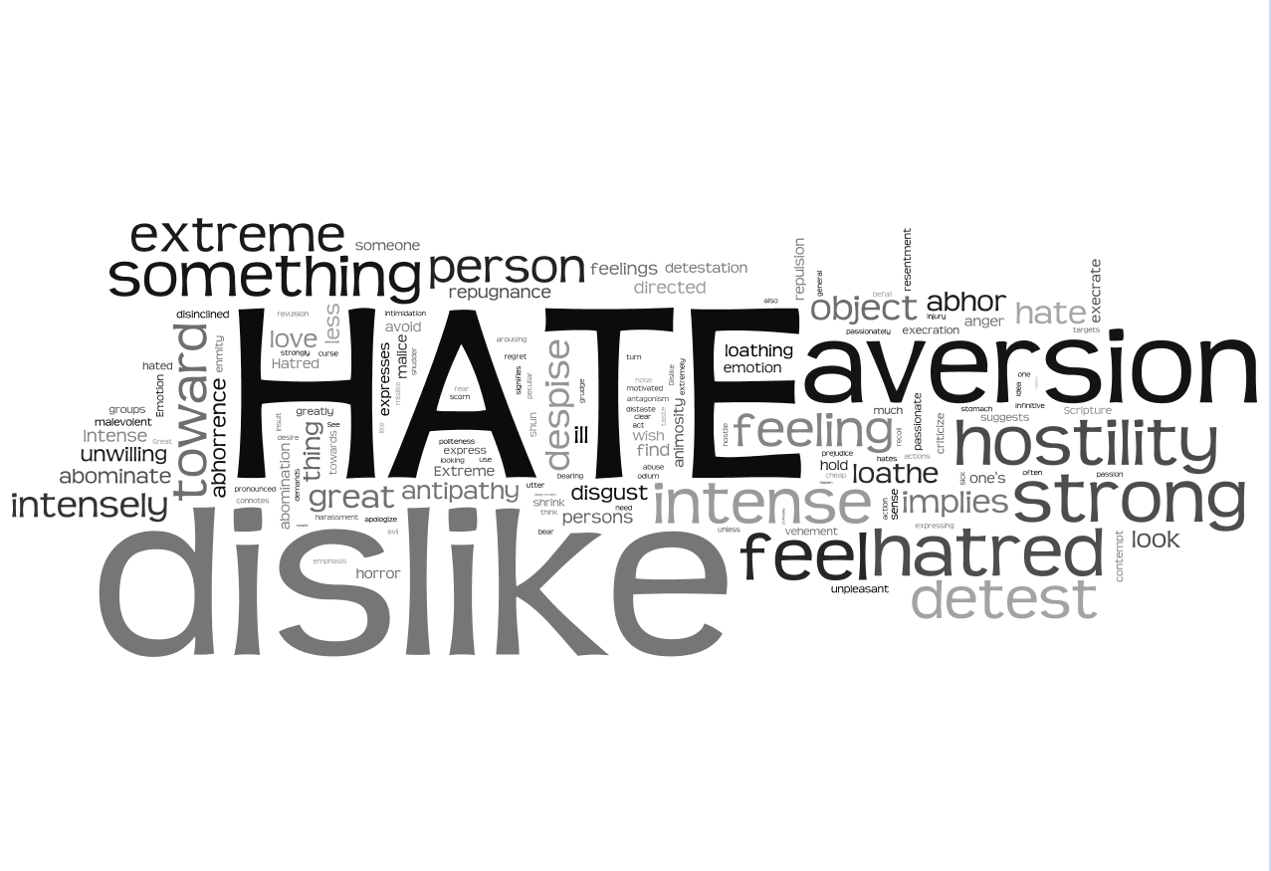

Slide 6
Summary Definitions of “Hate”
Verb:
To feel intense or passionate dislike for someone or something
To feel intense hostility, ill will, or aversion for someone or something
To negate intimacy, value, or love
To politely express one's regret or embarrassment over doing or requesting something
To be extremely unwilling to be or do something
To love less (scriptural definition)
To experience hatred
Noun:
Intense or passionate dislike, hostility, disgust, or aversion
An object or target of dislike, hostility, disgust, or aversion
The emotion or feeling of intense dislike
Learned perspective of aversion, hostility, or extreme dislike for someone or something
Learned moral resentment
Modifier
Hate speech
Hate groups
Hate crime

Slide 7
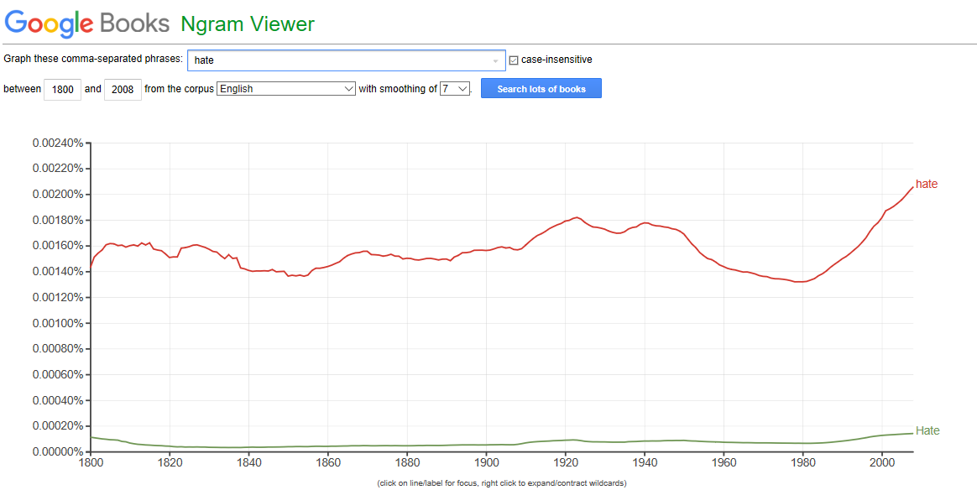
Frequency of use of the word “Hate” from 1800 - 2008
Highest frequency ever recorded
https://books.google.com/ngrams/graph?year_start=1800&year_end=2008&corpus=15&smoothing=7&case_insensitive=on&content=hate&direct_url=t4%3B%2Chate%3B%2Cc0%3B%2Cs0%3B%3Bhate%3B%
United States history from 2008 to present (2019) began with the collapse of the housing bubble, which led into the late-2000s recession, helping the Democrats win the presidency in 2008 with the election of Barack Obama, the country's first African-American president. NOTE: Data beyond 2008 is not currently available.

Slide 8
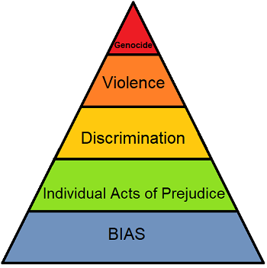
Pyramid of Hate
“A Horrific Pyramid
When we hear stories of the Holocaust in WWII, the atrocities in the Sudan and Rwanda, the many other acts of truly shocking violence and hate throughout history, most people wonder how anyone could do such things. How does national pride turn to death camps like the Nazis enacted in Germany?
What you must realize is that none of these acts started as a sudden decision to commit the most heinous acts of hatred and violence. They are built on smaller acts of hate, seemingly meaningless bias or rudeness. However, these acts lay the groundwork for greater and greater levels of hatred to grow into violent actions.
A good way to visualize this process is through the Pyramid of Hate, which sets simple things like having a bias against a group or listening to hateful jokes but not challenging them as the base of the pyramid and the support for escalating behaviors.”
https://study.com/academy/lesson/pyramid-of-hate-definition-examples.html

Slide 9
References
https://www.google.com/search?ei=e8_vXMzZKeGGggeX84TgBw&q=definition+of+hate&oq=definition+of+hate&gs_l=psy-ab.3..0l10.240140.244660..245259...0.0..0.76.991.18......0....1..gws-wiz.......0i71j0i67j0i131.kRWUC5-PXr4
https://thesaurus.yourdictionary.com/hate
https://www.merriam-webster.com/dictionary/hate#other-words
https://www.dictionary.com/browse/hate
https://www.vocabulary.com/dictionary/hate
https://en.oxforddictionaries.com/definition/hate
https://dictionary.cambridge.org/us/dictionary/english/hate
https://www.collinsdictionary.com/us/dictionary/english/hate
https://en.wikipedia.org/wiki/Hatred
https://www.yourdictionary.com/hate
https://science.howstuffworks.com/life/define-hate1.htm
https://www.thefreedictionary.com/hate
https://av1611.com/kjbp/kjv-dictionary/hate.html
http://www.learnersdictionary.com/definition/hate
https://www.thesaurus.com/browse/hate
http://dictionary.kids.net.au/word/hate
http://webstersdictionary1828.com/Dictionary/hate
https://study.com/academy/lesson/pyramid-of-hate-definition-examples.html
https://biblehub.com/topical/h/hate.htm
https://www.quora.com/What-is-hate-3?redirected_qid=12310795
https://en.wiktionary.org/wiki/hate
https://www.biblestudytools.com/dictionaries/bakers-evangelical-dictionary/hate-hatred.html
http://onlineslangdictionary.com/meaning-definition-of/hate-on
https://www.oxfordlearnersdictionaries.com/us/definition/english/hate_1
https://www.wordreference.com/definition/hate
https://stophate.tamu.edu/biashate-definition/

